Slide 1
Santé Innovations
>>Bringing health promotion to life

Slide 2
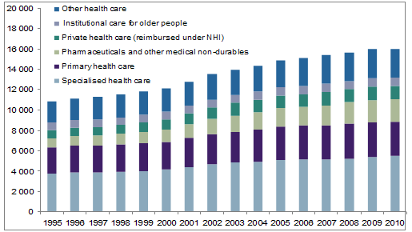
Problem:
Health care expenses are on the rise
Finland’s Health expenditure in 1995–2010
Sedentary lifestyle
Poor diet
Aging population
Terveydenhuollon menot ja rahoitus 2010
Notes:
The Finnish Red Cross is the most significant Finnish civic organisation providing humanitarian aid.
It makes sure, that everybody get’s blood when they need it and were working on this project to help them prevent blood shortages.

Slide 3
  In Finland, an average employee takes 5-15 sick days per year.
    >>That costs an average of 1500€ per employee per year.
Notes:
The Finnish Red Cross is the most significant Finnish civic organisation providing humanitarian aid.
It makes sure, that everybody get’s blood when they need it and were working on this project to help them prevent blood shortages.

Slide 4
We are:
An international, multi-professional team of specialists.
We create multi-platform health promotion media.
Our focus:
Preventative and promotional health care is cost effective.
Notes:
The Finnish Red Cross is the most significant Finnish civic organisation providing humanitarian aid.
It makes sure, that everybody get’s blood when they need it and were working on this project to help them prevent blood shortages.

Slide 5
Large companies
Government/Health Ministry
Non Profits/ Patient organizations
Target clients:
Market:
Our services and appeal are unique
Have advantage over other production companies because of our specialty and in-house knowledge
Notes:
The Finnish Red Cross is the most significant Finnish civic organisation providing humanitarian aid.
It makes sure, that everybody get’s blood when they need it and were working on this project to help them prevent blood shortages.

Slide 6
Clients buy customized health promotion material suited to their needs (example: animation)
Charge per hour for product creation
+ Hosting / Service fees
Business Model:
Projections:
Total income
Fixed costs
 | Year 1 | Year 2 | Year 3 | Year 4
Net | 18 992€ | 90 072€ | 214 440€ | 441 195€

Slide 7
Looking Forward:
> Expansion in year 3
> Pre-made catalogue of material
> Expansion to global markets
Ready-made product clients
Custom-made product clients
Notes:
Total picture of what we hope to achieve… goal profit per year?/figures…. How much money will investors make by investing in our company?

Slide 8
By keeping fixed costs low with rapid sales growth from pre-made material we expect:
  Revenue to increase by 150% yearly to 1 M € in year 5 without increasing our fixed costs
  With investment, we can expand our production capabilities and further increase sales
Goal:

Slide 9
Investment:
Steady 2 year growth builds solid framework for expansion
Year 3 investment needed for product development & expansion: 100 000 €
Return:
50 000 € investment = 5% company owner ship
Based on sales projections, investment will be returned at a rate of 200% in 3 years

Slide 10

Our customer:
Animation Goals:
Informative
Motivating
Multi-platform
Max. length of 1min 30
Demo
Notes:
Our challenge is to create a catchy, fun, informative animation to motivate young and older people to donate, but we especially want to motivate young donors.
Our customer is able to use this amazing animation with all different kinds of devices (smartphones, tablets, tv, website)
People love to watch this animation

Slide 11
Our Team:
Samppa Valkama – Developer
Ashley McNeill – Coordinator/Business
Monica Menniti - Health Care
Sampo Savolainen – Business/Developer

