Slide 1
Santé Innovations
Monica Menniti - Health Care
Samppa Valkama - Developer
Ashley McNeill - Business
Sampo Savolainen – Developer
Vann Nguyen - Design

Slide 2
Who are we?
An international, multi-professional team of specialists.
What do we do?
We create multi-platform health promotion media.

Slide 3
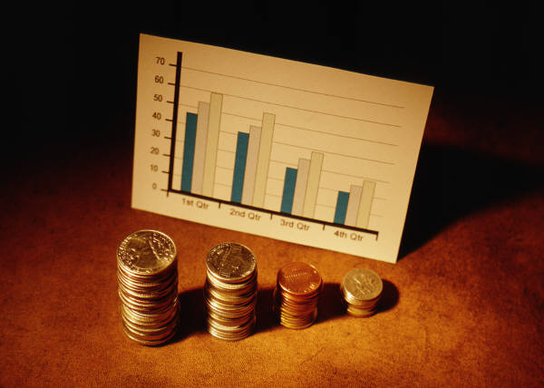
How much money per year does your company lose from employee sick days?

Slide 4
Common reasons for missed work in Finland:
musculoskeletal disorders(36 %)
(Other 42%)
These diseases can be helped and prevented if properly addressed
mental health disorders(22 %)
*Data according to TTL

Slide 5

  In Finland, an average employee takes 5-15 sick days per year.
    That costs an average of 1500€ per employee per year!
Would you like to decrease this amount?

Slide 6
Our Solution
Goal
Appealing, smart, informative products that will help your employees engage in healthier behaviors
We create media with a focus on health promotion
Experts from different fields create motivational, exciting, effective products for promoting health in different areas
A customized product for each individual client

Slide 7

1
How we do it
Tell us your companies health related problems
2
Our health care experts figure out the most effective way to decrease this problem
The final product will fit your needs- the multi-platform media can be experienced by your users in many ways.
(Ex: animations can be viewed with smartphone, tablets, browser, or even TV)
Easy distribution means maximum exposure and greater effectiveness.
4
3
Our development team turns this solution into a smart, modern, and appealing media product

Slide 8
Pricing Options
Custom
Full licensing rights
Billed per hour (100€/hr)
Pre-Designed
Price per pre-made product
Optional support package
Includes:
Full support and updates
Media Hosting
(600€/month) (Annual contract)
Optional support package
Includes:
Full support and updates
Media Hosting
(600€/month) (Annual contract)

Slide 9
If your company has 200 employees,
sick days are costing you 300 000 euros per year.
30% reduction from using our products=
90 000 € in savings per year!

Slide 10
Preventative and promotional health care is cost effective.

Slide 11

A small investment in our products now will save you thousands of euros in the long run.

Slide 12

Our customer
Notes:
The Finnish Red Cross is the most significant Finnish civic organisation providing humanitarian aid.
It makes sure, that everybody get’s blood when they need it and were working on this project to help them prevent blood shortages.

Slide 13
Animation
informative
motivating
Multi-platform
max. length of 1min 30
Demo
Notes:
Our challenge is to create a catchy, fun, informative animation to motivate young and older people to donate, but we especially want to motivate young donors.
Our customer is able to use this amazing animation with all different kinds of devices (smartphones, tablets, tv, website)
People love to watch this animation

Slide 14

Thanks for listening
Feel free to ask questions

