Slide 1
Optometry and eye-care in Scotland

Slide 2
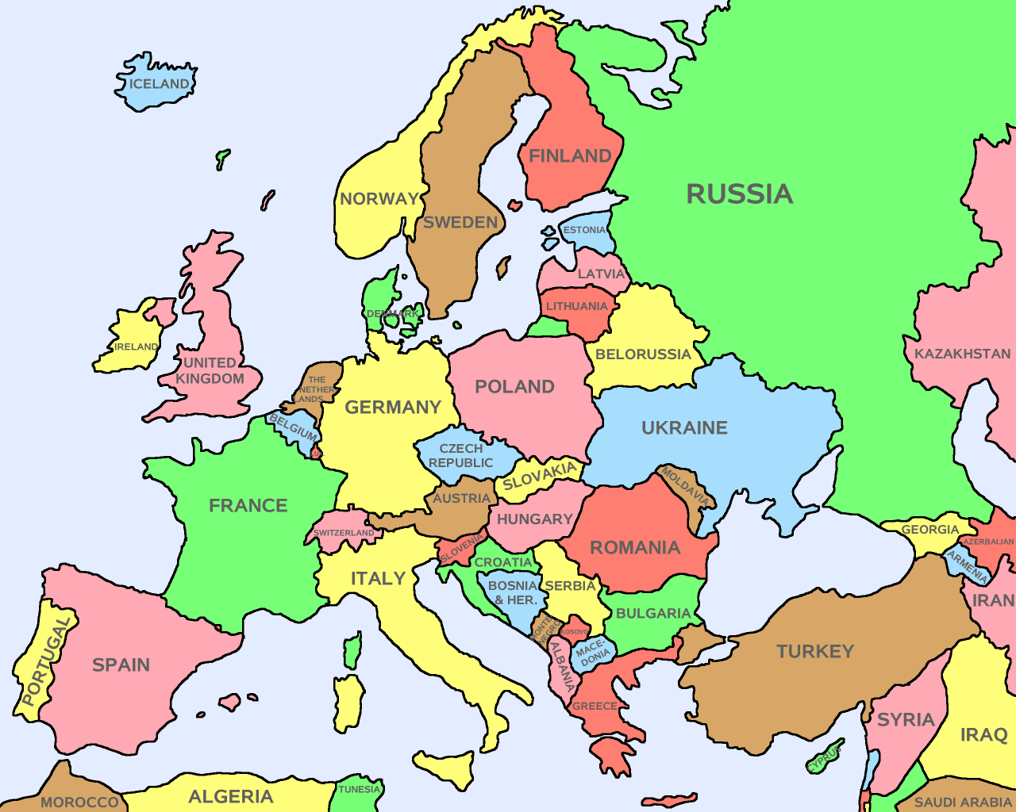

Slide 3
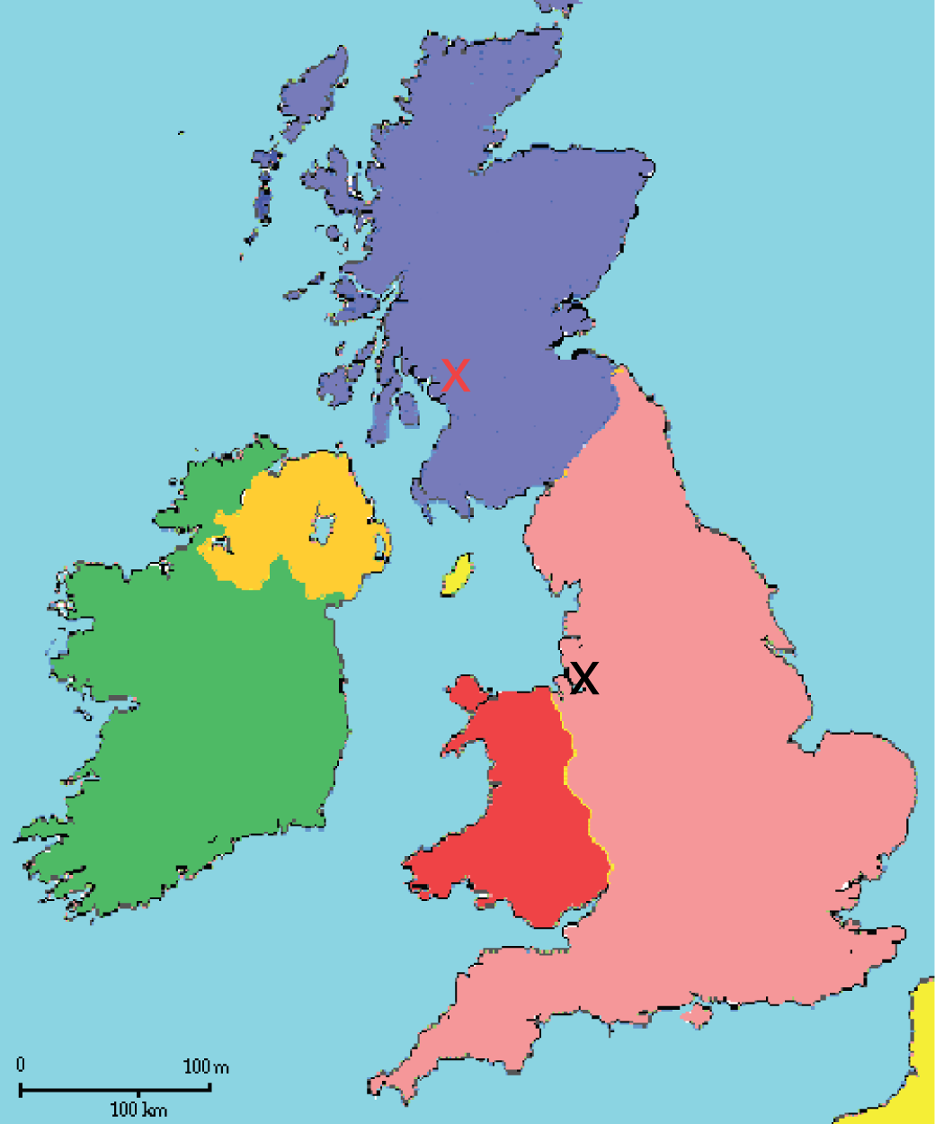


Slide 4
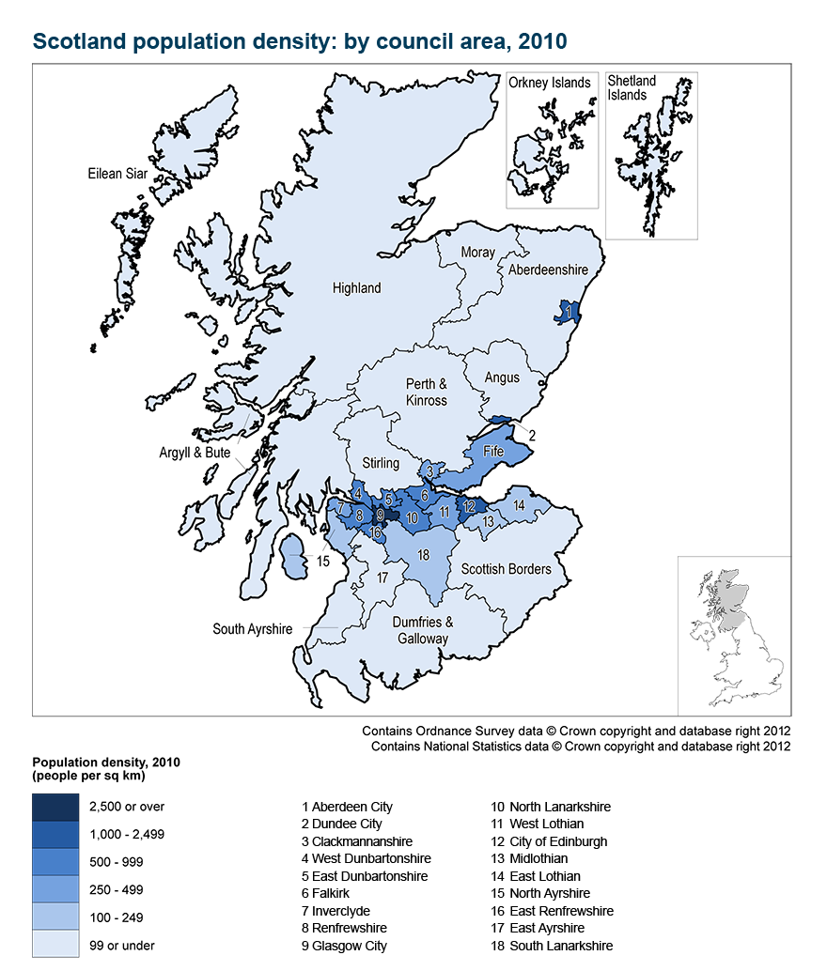

Slide 5
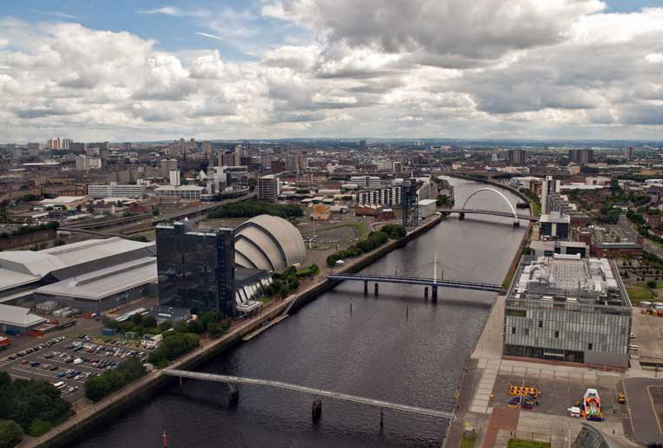
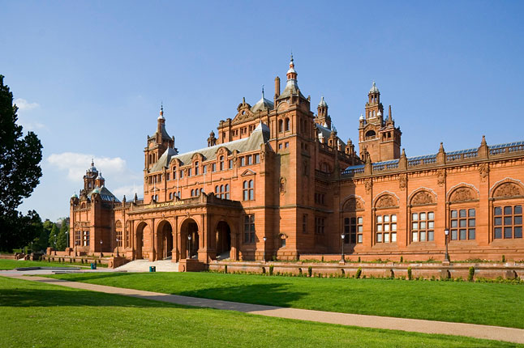

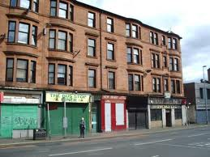

Slide 6
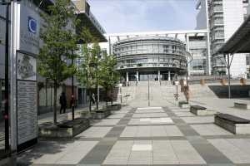
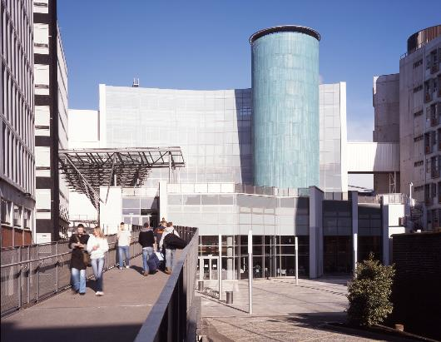
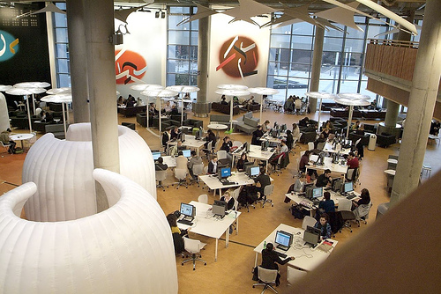
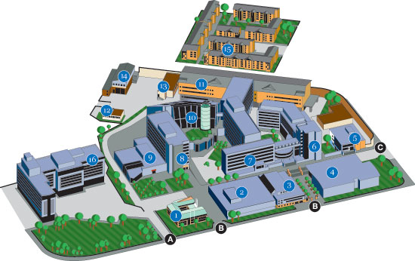

Slide 7
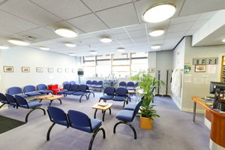
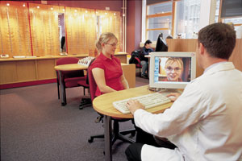
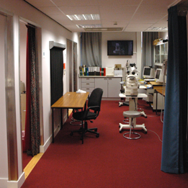
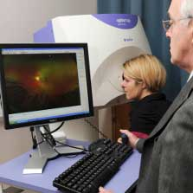
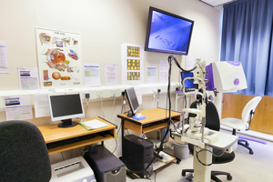
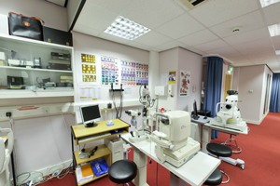
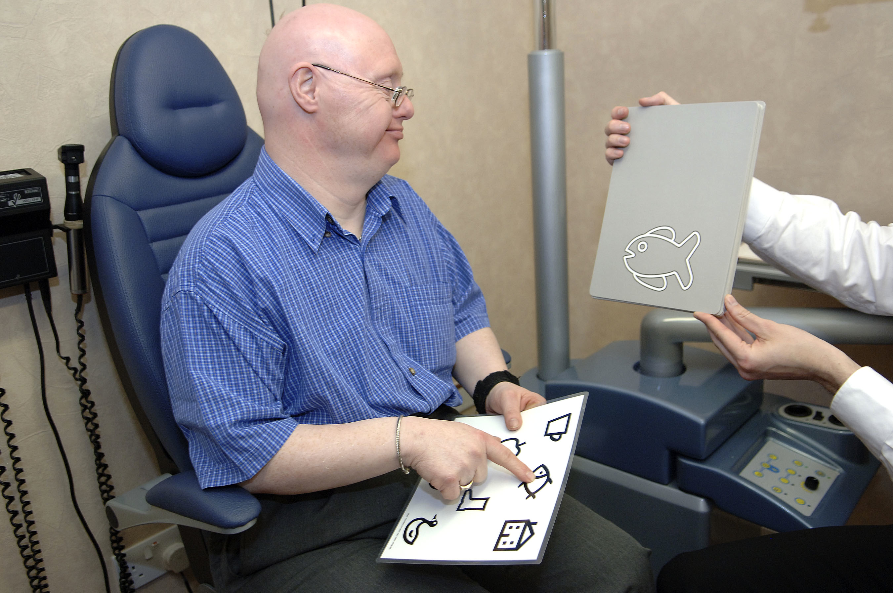

Slide 8
Optometry and eyecare in Scotland
1970’s UK-wide mode of practice very similar to Finland?
“lip service” to more
All UK healthcare tax-funded
National Health Service
Now
Scotland separate to rest of UK
  Spectacles expensive?
  Optometric responsibilities higher
  NHS pay (approx) 50€ for optometric eye examination
  20€ for “supplementary” examination

Slide 9
Ophthalmology
Very few
Optometry (GCU)
Refraction, dispensing, orthoptics, diagnosis, some treatment
  Rapidly expanding into therapeutic prescribing
  Full medical codex
  20% of optometrists by 2015?
Shared care in/ with HES
Rest of UK optometrists must pass extra exams to practice in Scotland
Orthoptics (GCU)
Binocular vision
Stroke recovery
Shared care in HES, taking on similar role to optometry

Slide 10
Ophthalmic dispensing (GCU/ distance learning)
Management and supply of spectacles
Future role?
Development being obstructed?
Optical assistants (NES/distance learning)
No formal training for most
Reception, supply of spectacles

Slide 11
Eyecare assistants (GCU)
Role not yet fully established
Early exit level from degree programmes
Using ophthalmic dispensing to enter another area at a lower level
  E.g. ”orthoptic assistant”, “clinical vision scientist(?)”
Clinical vision scientist
New profession – only 1 in Scotland
Generalist and specialist
Only 1 currently registered in UK (I think)
Formal clinical scientist training starting next year? (GCU only)

Slide 12
Minimum eye examination in Scotland
Full medical history
  Will have access to full medical records within 2 years
Refraction & binocular vision
Stereopsis & colour vision (children)
Slit lamp exam
Dilate over 60
Volk indirect ophthalmoscopy
Visual fields, repeat later date
Tonometry (contact of over 21), repeat later date
Retinal photography (over 60)
Soon? Gonioscopy & pachymetry when appropriate

