Slide 1
Mental and psychosocial health in Hungary
Dr. Anikó Osváth,
senior lecturer
clinical child psychologist
University of Pécs, Faculty of Health Sciences, Department of Health Development
Hungary
Notes:
Good Morning Ladies and Gentlemans.
Fist of all let me introduce myself. My name is Anikó Osváth. I am clinical child psychologist. I am senior lecturer at Department of Health Development, Faculty of Health Sciences, University of Pécs.
My focus on interest within psychology is developmental psychology on which I will touch upon later in my presentation.
As you can see I have a rather general title: Mental and psychosocial health in Hungary. Most naturally the title does not allow me to talk about all the important aspects of this topic. What I will do is focus/concentrate on the most important isssues.

Slide 2
Topics of the lecture
1. Socio-economic situation in Hungary
2. Hungarostudy research: 2002 and 2006:goals and methods
3. Results of this study
4. Explanation of the results
5. Mental and psychosocial health in childhood: the HBSC study
6. Social and health services which develop the mental and psychosocial health in childhood
7. One example: Child and Adolescent Psychiatric Outpatient Department in Pécs
Notes:
What you can see here is the plan of my talk. As you can see I have seven points. Actually the first four ……….are there to prepare the ground for the last three ones. Let’s see what we have here. First I would like to give a brief introduction about socio-economic stuation in Hungary. Then we will motion to comprehensive four-year research project which was carried out between 2002 and 2006. I wish to briefly summarize the results and discuss them. What really makes a difference in my presentation , I hope, is points five, six, seven. Point five would be ……………….The first thing I think I need to do is to deciphre/sort out HBSC. It is health-behavior in school aged children. To finish with I would like to present my hands-on experience with Child an Adolescent Psychiatric Outpatient Department. As a matter of fact this is my favourite subject area I work in.

Slide 3
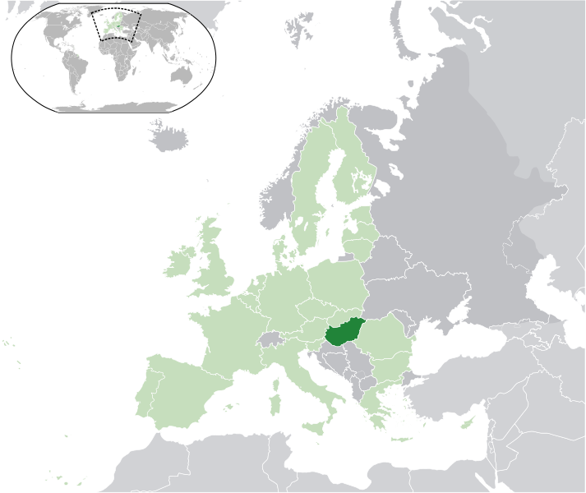
Hungary in Europe
Notes:
You will know and you can also see that Hungary is in the heart of Europe.

Slide 4
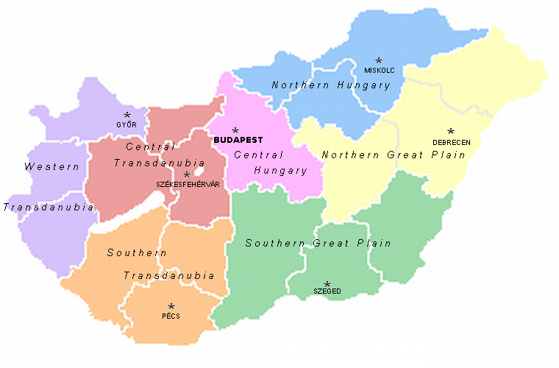
The regions of Hungary
20 regions which are the 19 counties and the capital city Budapest
23 towns with county's rights
Total area:
93030 km²
Population:
9 942 000
Notes:
Have a look at these data. Apparently it is a small country. In the southwest there is something you have already heard from me today. This is Pécs, the fifth biggest Hungarian city, one of the four University cities of the country.

Slide 5
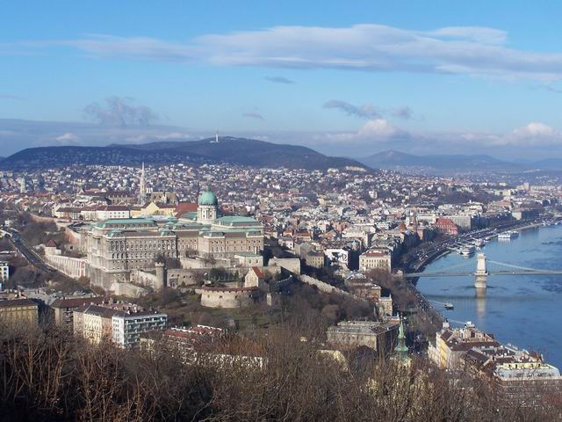
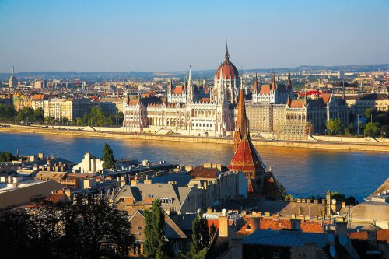
Capital city, Budapest
The Parliament with the Danube
Capital city, Budapest
Castle of Buda

Slide 6
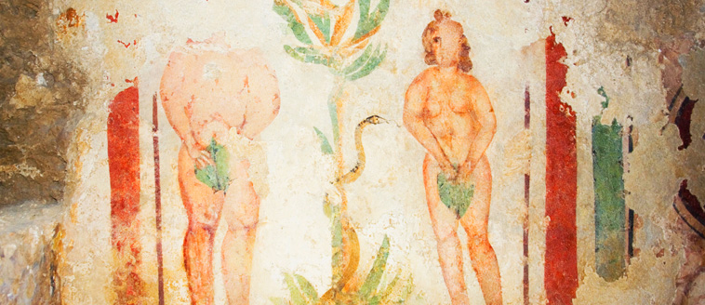
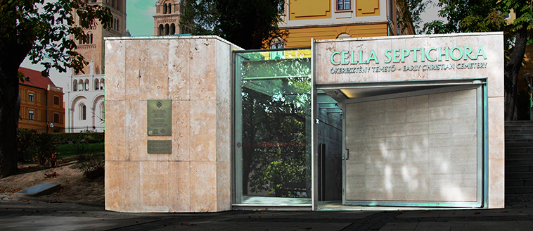
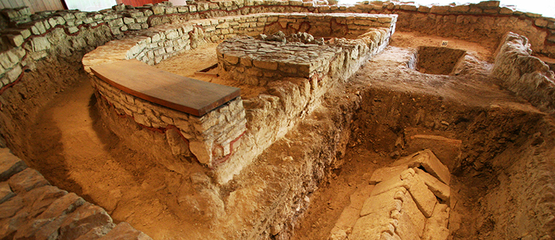
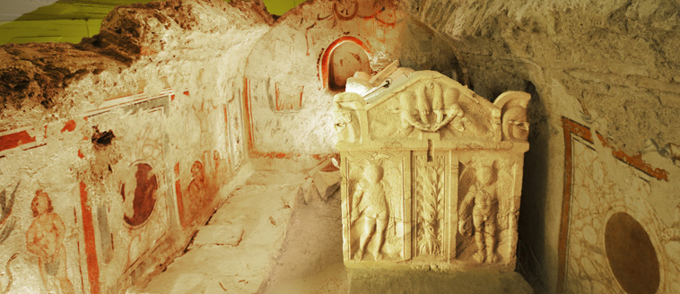
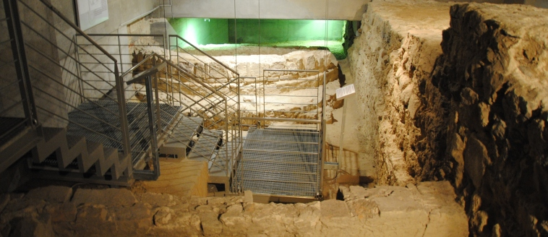
Pécs, Ancient Christian Burriel Chappels
Notes:
You must have heard that in 2010 Pécs was the Culture Capital of Europe. Our Ancient Christian Burrial Chappels 25 meters under the ground are part of the World Heritage.
Pécs has always been and still a multicultural city. Relics all over the town witness ancient historical ages. Let’s have a glimpse at the ruins architecture of the Roman times.

Slide 7
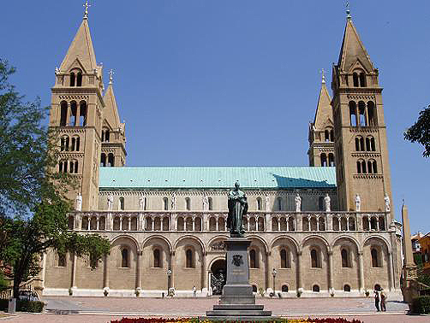
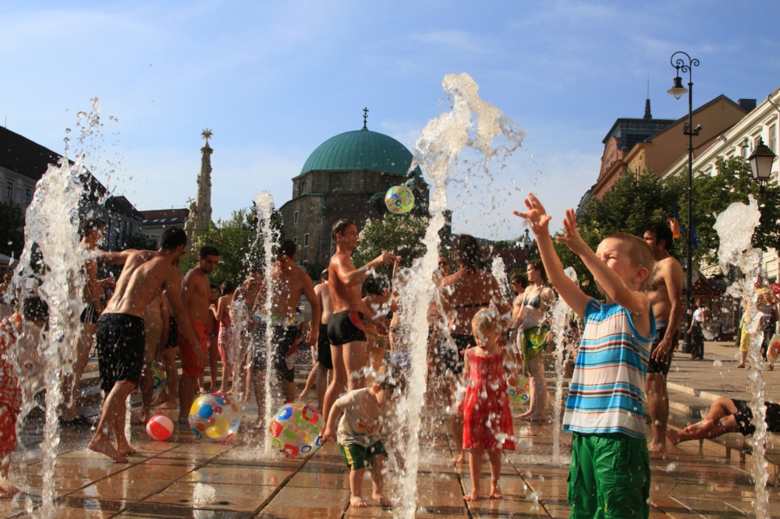
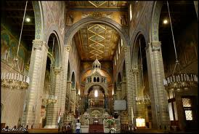
Cathedral
Pécs
Turkish Mosque at the Széchenyi Square
Notes:
The middle ages are represented by the Cathedral founded our first king, King Stephen the first. A most prominent building in the very centre of the city is a Turkish Mosque which was converted into a christian church after the Turks left in the 17th century.

Slide 8
Socio-economic situation in Hungary

Slide 9
Source: OECD Health Data, 2012
 | Hungary |  | Finland
 | 2006 | 2010 | 2006 | 2010
Total health expenditure: % of GDP | 8,3 | 7,8 | 8,3 | 8,9
Physicians density per 1000 population | 3,0 | 3,3 | 3,0 | 2,9
Total hospital beds per 1000 population | 7,9 | 7,2 | 7,0 | 7,9
Psychiatric care beds per 1000 population | 0,4 | 0,3 | 0,9 | 0,8
Life expectancy female pop. at birth, years | 77,4 | 78,1 | 83,1 | 83,5
Life expectancy male | 69,0 | 70,5 | 75,9 | 76,9
Life expectancy total pop. | 73,2 | 74,3 | 79,5 | 80,2
Notes:
Here we can see some socio-economical data about Hungary, which are related/bear a relation to the mental and psychosocial health.
Have a look at these data: We could compare the hungarian data with the finnish. What really makes a difference is data about life expectancy, especially by the male population. In Hungary live the men with 6, the women with 5 years shorter, like in Finland.

Slide 10
 | Hungary |  | Finland
 | 2006 | 2010 | 2006 | 2010
Infant mortality (deaths per 1000 live birth) | 5,7 | 5,3 | 2,8 | 2,3
Unemployment rate | 7,4 | 11,2 | 7,7 | 8,5
Intentional self-harm death per 100 000 population | 23,4 | 23,3 | 19,6 | 17,3
Alcohol consumption (liters per capita age 15+) | 13,2 | 11,5 | 10,1 | 9,7
Obesed population, measured % of total population |  | 28,5 |  | 20,2
Notes:
Other issues of the mental and physical health in Hungary are also less beautiful, like finnish data: I wish to underline the number of intentional self-harm death which has been beginning to decrease, but in smaller rate like in Finland. Today it is still reasonably high.

Slide 11
„Central-Eastern-European health paradox”
1960: vast majority of the population lived at similarly low level,there were no mortality differences between socio-economic strata.
Socio-economic situation: growing polarisation between 1960 and 1990.
Widening socio-economic gradient in mortality.
Mortality rates continued to decline in Western Europe, increase in Hungary, especielly among middle-aged men:
Mortality rate for 1000 men
1960: 12.2
2005: 16.02 increasing=33%
Notes:
On the next two slides I wish to account for the high mortality rate in Hungarian males. The most important reason for it is the ………
The mortality rate among middle-aged increased among 1960 and 2005 with 33 percent.

Slide 12
„Central-Eastern-European health paradox”
Among women mortality rate decreased.
Cardiovascular mortality accounts for the majority of this excess mortality.
Male/female differences in life expectancy 8.3 years (2004).
Mortality rate comparing the lowest to highest educational stratum:
1.8 for males
1.2 for females
Since the late 1980s, the mortality rates among 45-64 year old men in Hungary has risen to higher levels than they were in the 1930s.
Notes:
We can see the mortality rate depends on the qualification in very large extent.
Since the late 1980s, the mortality rates among 45-64 year old men in Hungary has risen to higher levels than they were in the 1930s, as you can see at the next diagram.

Slide 13
Source: Kopp, M, Skrabski Á: Depression predicts male premature mortality, 14th AEP Section Epidemiology and Social Psychiatry

Slide 14
Hungarostudy research: 2002 and 2006:goals and methods
Notes:
Next I would like to briefly summarize the National representative surveys in Hungary, called Hungarian Epidemiological Panel.

Slide 15
National representative surveys in Hungary:
Hungarian Epidemiological Panel
The samples represent the Hungarian population above age 18, according to gender, age, county and subregions
Hungarostudy: 1983: 6000 persons
1988: 20 092 persons
1995: 12 463 persons
2002: 1 2640 persons
2006: follow-up study: among the
12 640 persons in Hungarostudy 2002 4689 persons were interviewed again, 322 persons deceased
Notes:
Hungarostudy surveys were performed since 1983 on 5 occasions. In 2002 …………persons participated in the survey.

Slide 16
Measures
1. Socioeconomic Factors
Education
Occupational class
Personal and household income
Subjective social status
2. Work-related stress factors
Control available at the workplace
Job security
Dissatisfaction with the job
Social support from collegues
Notes:
As you can see the following data were measured in the survey.

Slide 17
Measures
Mental health factors
Depressive symptoms (Beck Depression Inventory, shortened version)
Self-efficacy score
Anxiety (Hospital Anxiety Score)
Type D personality (Dennollet, 2000: negative affect, behavioral inhibition)
Hopelessness (Shortened Hopelessness Score, Beck, 2000))
WHO Wellbeing
Social support
Notes:
Type D……which includes the scale of

Slide 18
Measures
Health behaviour
Smoking history
Suicidal behaviour
Physical activity
Alcohol abuse
Body weight and height: BMI
Drog consumption

Slide 19
Results of this study
Notes:
Let’s see the most important results of this surveys.
It was found that…

Slide 20
Middle-aged sample: predictors of early death
Hungarostudy 2002:
1130 men
1529 women
Were between the age of 40-69. From this group
99 men (8.8%)
53 women (3.5%)
Died till 2006.

Slide 21
Middle-aged sample: predictors of early death
Among men:
Depression, especially severe depression
Anxiety
Self-rated health, especially self-rated disability
Work-related factors: job insecurity, low control in work, low personal and family income, low employment grade
No meaning in life, hopelessness
Low education
Subjective poverty, subjective social status

Slide 22
Middle-aged sample: predictors of early death
Among women:
Dissatisfaction with personal relations, family problems, social support at work
Family related socioeconomic measures (no car in the family)

Slide 23
Explanation of the results

Slide 24
Chronic stress and depression
Hungary: „masculine” society: assertive and competitive.
Men accept: they are responsible for the economic situation of the family. Unfavourable social and economical changes is a more important stressor for men, than for women.
Poor socioeconomic situation in itself does not cause higher morbidity rates , only through the mediation of depressive symptoms. The subjective experience of relative disadvantage, the prolonged negative emotional state, that is chronic stress proves to be the most important health risk factor.

Slide 25
Chronic stress and depression
Poor socioeconomic situation
Depression
Self-rated morbidity (sick)

Slide 26
Chronic stress and depression
Severe depression increased between 1988 and 1995 from 2.7% to 7% in the total population
Between 2002 and 2006 increased severe depression among men and women too, but with higher proportion among men.

Slide 27
Source: Kopp, M, Skrabski Á: Depression predicts male premature mortality, 14th AEP Section Epidemiology and Social Psychiatry

Slide 28
Source: Kopp, M, Skrabski Á: Depression predicts male premature mortality, 14th AEP Section Epidemiology and Social Psychiatry

Slide 29
Source: Kopp, M, Skrabski Á: Depression predicts male premature mortality, 14th AEP Section Epidemiology and Social Psychiatry

Slide 30
Health Behavior in School-Aged Children (HBSC) 2010
WHO-Collaborative Cross National Study National Report
Hungary: National Institute of Child Health (OGYEI) Budapest
Notes:
After the data of the adult population in Hungary let’ see the school-aged children and adolescent. How good or bad is the mental and psychosocial health among them?

Slide 31
Goals of the Survey
Study the patterns of health among young people in 41 countries and regions across Europe and North America.
Report on health, health-related behaviour and the social contexts of young people’s health.
Inform and influence policy and practice and contribute to health improvement for all young people.

Slide 32
Methodology
HBSC study has to be conducted according to the internationally developed and approved research protocol.
Selecting age groups of pupils with
11 (1877), 13 (1903) 15 (2243), 17 (2091)-year-old age group,
5th, 7th, 9th and 11th grade students
were considered as target population in this study.
Current analyses were done within the Hungarian nationally representative sample.

Slide 33
Methodology
Data collection: in the classrooms, with anonymous self-reported questionnaires
416 classes of 358 schools
Strata were created by geographical regions, by settlement size, by secondary school type
School types were: grammar school, technical college, vocational school
Cleaned sample contains 8096 questionnaires

Slide 34
Results: physical activity and sedentary behaviour
Physical activity: has a positive effect on mental health,mental performance, social relationship.
School-aged children: devote much more time on physically passive activities than active ones.
More than half of the students, 58.2%, watch TV at a least two hours a day on schooldays and 82.7% in the weekend.
17.3% of the pupils do exercise regularly for at least 60 minutes in a day. Rates decrease sharply approaching grade 11.

Slide 35
Results: physical activity and sedentary behaviour
How many days did they physical activity: over the past week: 11,13,15,17 year-old age groups, girls and boys (n=7955)
at least 60 minutes physical activity, at the day, %
Source: Serdülőkorú fiatalok egészségmagatartása és életmódja, OGYI, 2011.
Notes:
Health behavior and life style in adolescents

Slide 36
Results: tobacco smoking
The age of the first trial is very improtant: the earlier the young people start smoking the greater chance they have got to become a regular smoker in adulthood.
Most of the students in grade 9 have their first cigarette at the age of 13-14.
Smoke at least once a week: 21%
Smoke on daily basis: 16.8%
Daily users among current smokers: 63.4%
Significant differences between secondary school-types: indicators of students attending vocational schools are much less favorable than those of students from grammar schools and technical colleges.

Slide 37
Results: alcohol consumption
Have already consumed alcohol at least once in life: 72.2%:
Gender differences in all ages: number of girls who drink alcohol at least once a week is much lower, than those of boys.
Have never been drunk in life: 53.1%
Age of first drunkenness is age of 14 among 9th grade boys, 14 and 15 years among 9th grade girls and 16 years among 11th grade students.
Most respondents first tasted an alcoholic drink around the age of 14 years, boys earlier than girls.
Indicators of drinking behaviour are much higher among vocational school students than those of students from grammar schools and technical colleges.
The shares of alcohol consumption by young people in Hungary show an average number in comparison with other European countries.

Slide 38
Results: illegal drog consumption
9th and 11th grad students: 30.7% has already tried illegal drogs, or abused medicines or inhalants in their life.
Most students: experimental drug users.
Cannabis is the most popular drog, the second most popular substance use is abuse of medicine.
Last year prevalence of cannabis use is 15.8% in the whole sample.
Indicators of the drug using are much higher among vocational school students than those of students from grammar and technical schools.
Results show higher prevalence of cannabis use in secondary school students, comparing to previous surveys.

Slide 39
Results: illegal drog consumption
Cannabis use prevalence in the last month among the different type of drug users among the 9th and 11th grade pupils
Rate of the users (%)
Social-recreational user
Situational user
Intensive user
Source: Serdülőkorú fiatalok egészségmagatartása és életmódja, OGYI, 2011.

Slide 40
Results: sexual behavior
40.6% of the pupils of 9th and 11th grade have had sexual intercourse
The pupils who have already had sexual intercourse (N=4552)
Sexually active pupils%
9th grade
11th grade

Slide 41
Results: sexual behavior
Beginning of sexual activity shows acceleration: 50 % of sexually experienced children attending grade 9 started sexual activity at the age of 14 or before, while just 20% of students of grade 11 started sex at this age.
Compared to the 2006 data a slight increase was observed in the rate of children obtaining their first sexual experience at the age of 11 or before

Slide 42
Results: subjective well-being
HBSC Symptom Checklist
Girls had higher scores than boys
Among girls scores increased with age
Frequent (more times a week) psychological symptoms more pronounced among girls and older students:
Irritable bad temper
Feeling low
Nervous
Pain symptoms: frequent backache

Slide 43
Results: subjective well-being
Frequent somatic symptoms:
Sleeping problems
Pain in the head, stomach, back
Tiredness (50% of the students in 11th grade)
General life satisfaction:
Significant decline in levels of life satisfaction between
grade 5 and 11.

Slide 44
Results: subjective well-being
Depression
Scores on shortened version of Child Depression Scale, gender differences (N=4944)
Four or more points may indicate depressive mood
Girls scored significantly higher than boys
Proportion of the students (%)
O-1 point
2-3 point
4-16 point
Scores reached on Child Depression Scale

Slide 45
Results: school, bullying, peer relations
Liking the school: among students attending vocational schools significantly less respondents like their school very much than among students of grammar and technical schools .
Bullying: two-third of the students are not exposed to bullying, 15 % are perpetrators, 13% are victims, 10% are both participating in and suffering bullying.
More boys are perpetrators, bully-victims and those who are not exposed to bullying at all.
In older age groups: prevalence of bullying is sign. lower.
Vocational schools: sig. more perpetrator and victim-type children.

Slide 46
Social and health services which develop the mental and psychosocial health in childhood

Slide 47
Children and adolescent mental health care/specialists
Special education teacher
Pediatricians
Health visitor
Healing the physical diseases
Helping the development of child
Develop the mentally disabled children
Child psychiatrist
Child psychologist
Social worker
Psychological problems and psychiatric disorders
Notes:
Child and adolescent mental health care in Hungary
In children and adolescents years of health care, promoting the development of pediatricians and health visitor performed. The physical diseases healing of children and adolescents (0-18 years) are task of pediatricians, and health visitor help their development. The pszichological problems and psychiatric disorders of children and adolescents will be treated by childpsychiatrists and childpsychologists in different institutions .

Slide 48
Children and adolescent mental health care/institutions
Child psychiatric clinical department: 3 in Hungary
Child psychiatric outpatients’ department: in every county
Educational consultation: schooling problems
Child welfare services: financial and psychological help to children of disadvantaged family
Private practices: child psychiatrists and child psychologists
Notes:
There are some specific childpsyhiatric clinical department, the expert dealing predominantly in out-patient instituts with the problematic children. In cities available an „educational counseling agency” for preschool children and school-aged children and their parents. The „child welfare sevices” provide financial and psychological help to children of disadvantaged families. Such services operates in every settlement.
Those children who have mental disorders are receiving treatment in childpsychiatric out-patient clinics. In this medical institution may be the method of the treatment drog medication and psychoterapeutic process.
Many child psychiatrist and child psychologist work in privat praxis in capital and other major cities.

Slide 49
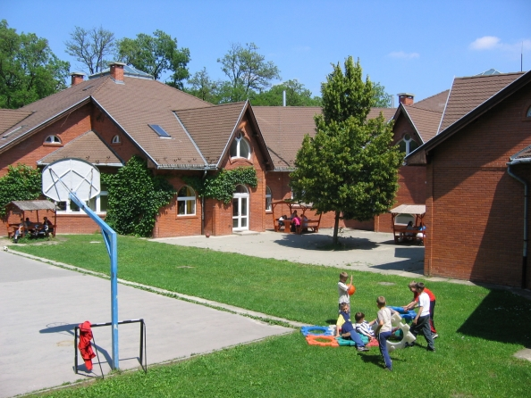
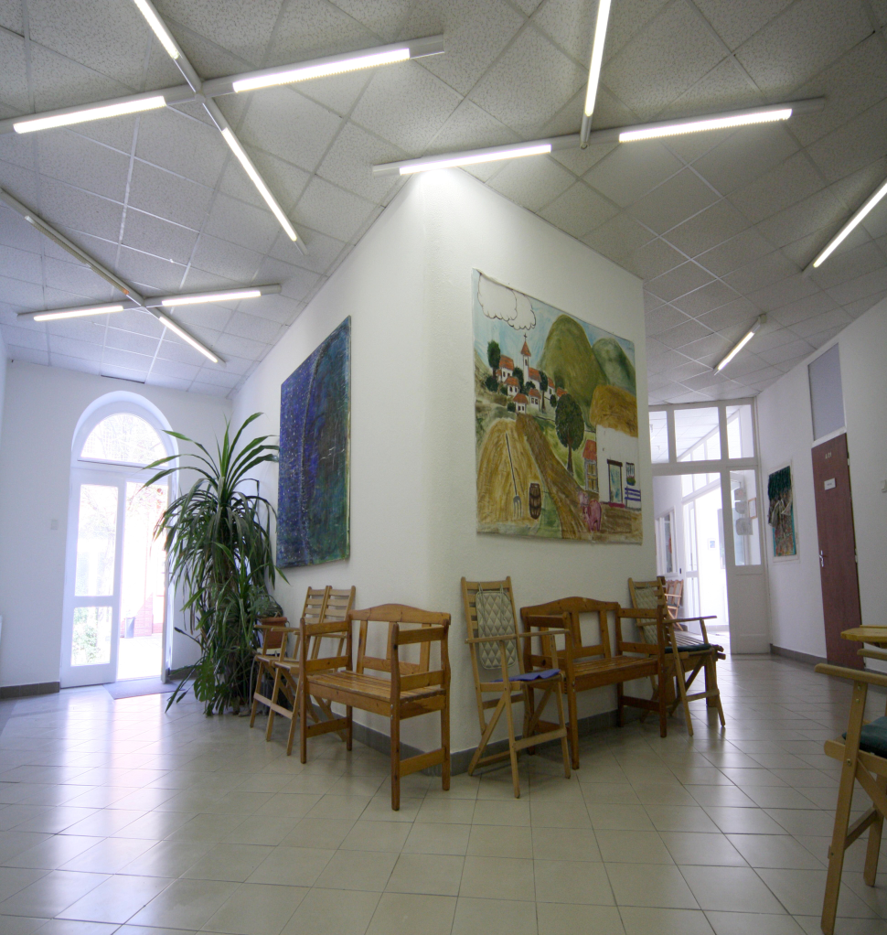
The Vadaskert Child Psychiatry Hospital and Outpatient Clinic
Notes:
Established in 1989, the Foundation for Children's Mental Health defined its goal in the Deed of Foundation as the establishment of a state-of-art model, which manages the medical, educational and social problems of psychologically ill children within one institution. In accordance with its original goal, the Foundation operates several interdependent units with different tasks.
The Vadaskert Child Psychiatry Hospital and Outpatient Clinic has been operating since 1993 and provides child psychiatry service financed by the National Health Insurance Institute. It has three inpatient units, with a total of 40 beds and a capacity of 20 day-care patients. The Hospital admits about eight-nine hundred patients to its inpatient wards yearly and provides day-care for nearly three hundred patients. Last year, the Outpatient Clinic had 1400 new patients, and provided care to both children and adults in nearly 14,000 visits.

Slide 50
The Vadaskert Child Psychiatry Hospital and Outpatient Clinic
Since 1993 three inpatient units, with 40 beds, and a capacity of 20 day-care patients
Last year the Outpatient Clinic had 1400 new patients, and provided care to both children and adults in nearly 14,000 visits.
It manages the medical, educational and social problems of psychologically ill children within one institution
It is maintained by a foundation, but is financed by the National Health Insurance Institute.
Notes:
maEstablished in 1989, the Foundation for Children's Mental Health defined its goal in the Deed of Foundation as the establishment of a state-of-art model, which manages the medical, educational and social problems of psychologically ill children within one institution. In accordance with its original goal, the Foundation operates several interdependent units with different tasks.
The Vadaskert Child Psychiatry Hospital and Outpatient Clinic has been operating since 1993 and provides child psychiatry service financed by the National Health Insurance Institute. It has three inpatient units, with a total of 40 beds and a capacity of 20 day-care patients. The Hospital admits about eight-nine hundred patients to its inpatient wards yearly and provides day-care for nearly three hundred patients. Last year, the Outpatient Clinic had 1400 new patients, and provided care to both children and adults in nearly 14,000 visits.

Slide 51
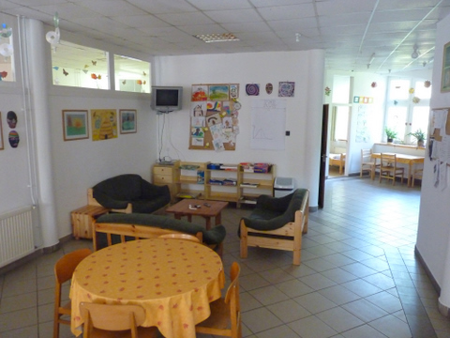

The Vadaskert Child Psychiatry Hospital and Outpatient Clinic/inpatient ward
At the ward called MÉHKAS ("BEEHIVE"), inpatient psychotherapeutic groups are organized for youths (10-18 years of age) with similar psychopathology:
ADHD, eating disorders, anxiety problems, OCD, Tourette Syndrome, learning disabilities, mood disorders
The disorder-specific treatment programs take one or two weeks and contain
cognitive-behavioral methods, social skill training for children
parental consultations at the beginning and at the end of the programs. Parental psycho education includes introducing to the nature of the disorder and the possible management of related problems.
Notes:
The primary problems that children, adolescents and their parents turn to Clinic for help from Budapest and the whole country are affective, conduct, anxiety and eating disorders, attention and learning problems, speech and other disabilities, pervasive developmental disorder. We currently provide care for patients in interconnected modules, which partially overlap and support each other.
At the ward called MÉHKAS ("BEEHIVE"), inpatient psychotherapeutic groups for youths with similar psychopathology (ADHD, eating disorders, anxiety problems, OCD, Tourette Syndrome, learning disabilities ect.) are organized. The disorder-specific treatment programs take one or two weeks, with parental consultations at the beginning and at the end of the programs. Parental psycho education contains introduced to the nature of the disorder and the possible management of related problems.

Slide 52
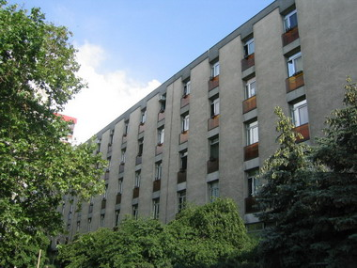
Child and Adolescent Psychiatric Outpatient Department in Pécs

Slide 53
Some data about the Outpatient Department
Functioning as part of the Outpatient Clinic in Pécs, in the same building with other outpatient departments
It was founded in 1957
Provided region: first of all Pécs, and Baranya county, but some patients come from other areas of Southern Transdanubia
Focus age-group: 0-18 years

Slide 54
Experts in the Outpatient Department
5 child psychiatrists
3 clinical child psychologists and 2 psychologists
1 mental health specialist
2 special education teachers
2 psychiatric assistants/receptionists
Some of the psychiatrists/psychologists have cognitive-behavioral or integrative psychoterapeutic qualifications.

Slide 55
Relationships of the Outpatient Clinic:
Signaling the problems and referring the patients
Collaborating with them in treatment in cases
Outpatient clinic
Pediatricianshealth visitors
Child welfare services:
social workers
Educational consultation
Kinder-gartens,
schools
Hospitals and clinics

Slide 56
Types of the problems
Preschool children: difficulties of a mother-child relationship, delay of psychomotor or mental development,
School-aged children: ADHD, anxiety disorders (separation anxiety, schoolphobia), conduct disorders,
learning disabilities, affective disorders
Adolescence: OCD (obsessive-compulsive disorder), anxiety disorder, depression, alcohol or drog abuse, eating disorders (anorexia nervosa, bulimia nervosa)
Family problems: divorce, death, existential crisis, child abuse
Notes:
symptoms of anxiety, or problems with the regulation of emotions, affects and impulses

Slide 57
Everyday work in the Outpatiant Clinic
Registra-tion
mostly on telephone or personally: parent or member of the „signaling-system”
psychiatrist: fixing an appointment
Exploratory interview
psychiatrist: performing it with parent and child
after it discussion with psychologist or/and special education teacher
Diag-
nostic process
psychologist: psychodiagnostic methods with the child: drawing and playing tests, rating scales, mental abilities tests
psychiatrist: biographical and family analyses with parents
special education teacher: learning abilities
Notes:
includes observation of the child's behavior and detailed exploratory interviews conducted with the child and the parents. Besides the examination by a child psychiatrist, the exact clarification of the problem and the preparation of a treatment proposal is aided by psychological, neuropsychological and special educational tests. Laboratory, electrophysiological or imaging examinations are also conducted, if needed.

Slide 58
Everyday work in the Outpatiant Clinic
Other methods
Mental health specialist: observing the child in kindergarten, school, or at home, consulting with teachers about problems
Diag-nosing
Psychiatrist, psychologist: discussing with the parent or with the parent and adolescent the results of the diagnostic process and the possible therapies
Therapy

Slide 59
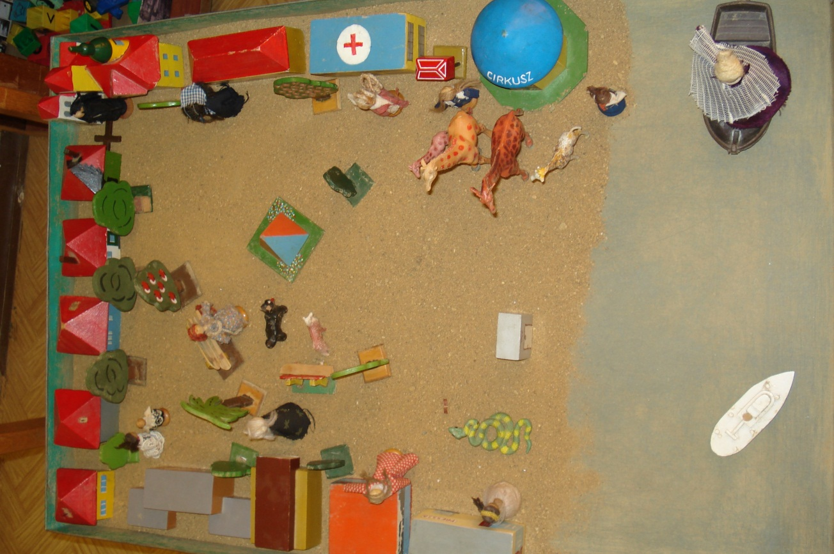
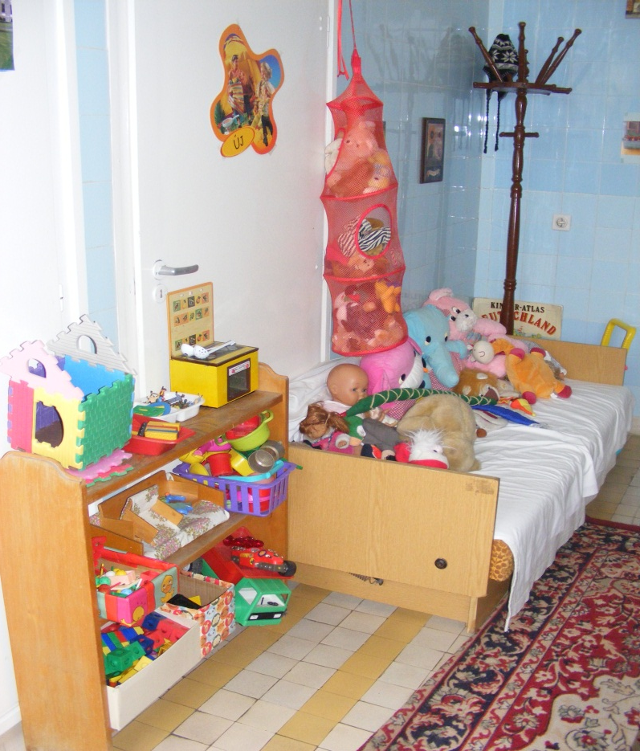
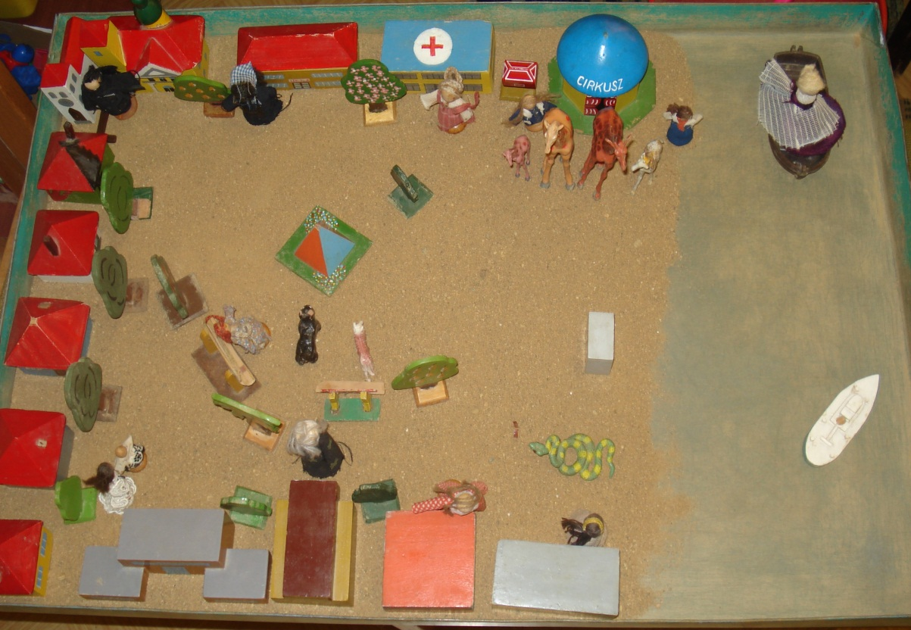
A room in the Outpatient Clinic
„World-play” – a playing
test

Slide 60
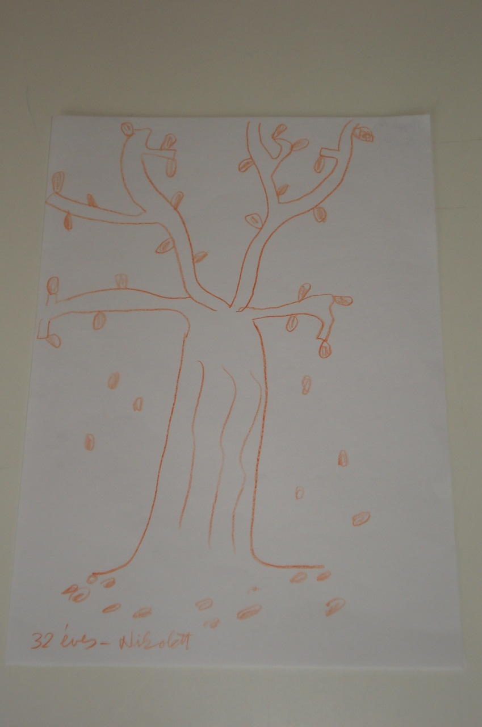
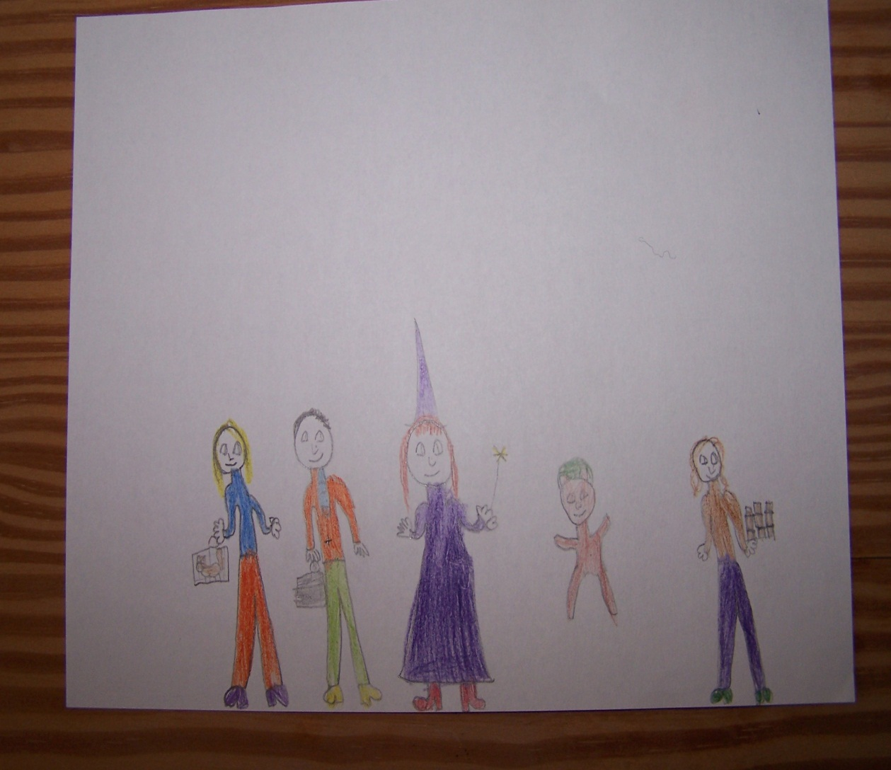
„Draw a tree!”-a drawing test
„Draw your family!”- a drawing test

Slide 61
Forms of therapy
Individual forms
Psychiatrist: parental consultations pharmacotherapy (when needed), psychotherapy with adolescents
Psychologist: play or art-therapy, cognitive-behavioral therapy, supportive therapy
Psychoterapeutic groups
Group for adolescents with different problems: develop social skills, self-efficiacy, self-knowledge
Psychoeducational group for parents of children with ADHD
Art-therapy group for preadolescents with anxiety disorders

Slide 62
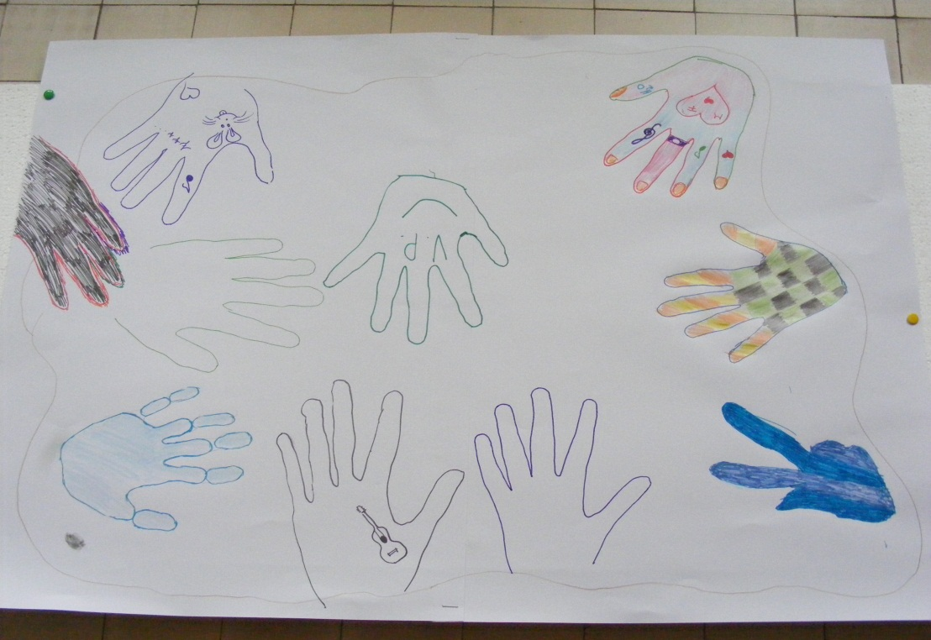
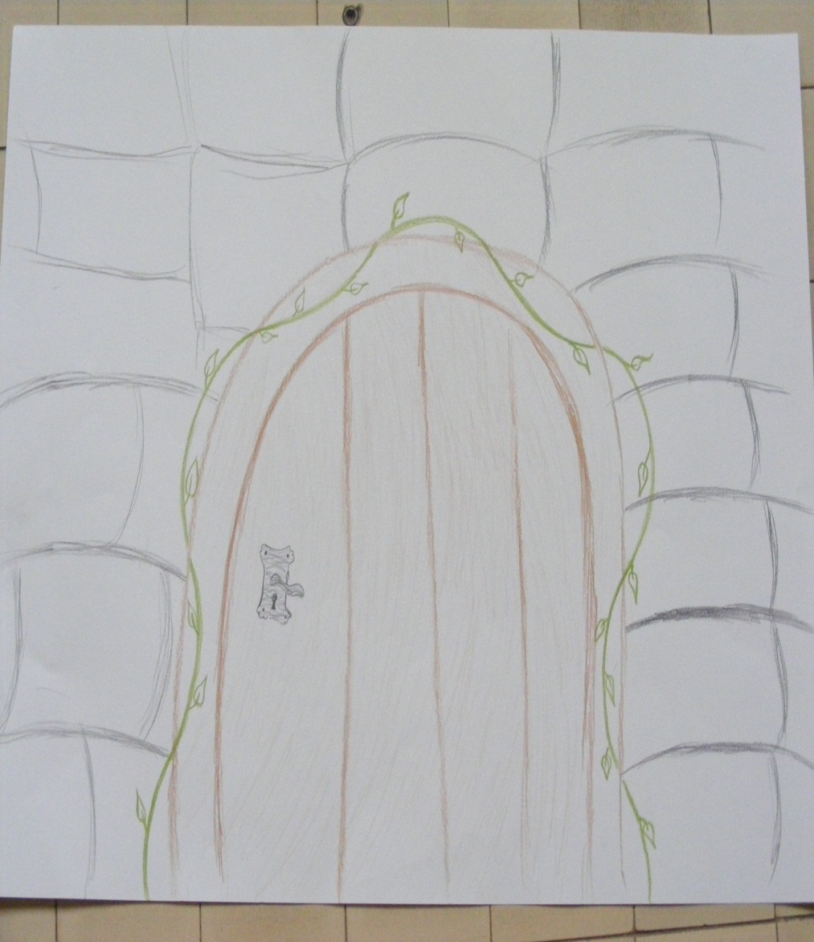
Group for adolescents
Working with symbols: the door
Group-forming task: together on the island

Slide 63
Other activities
1. Case-discussing group with the specialists of other Institutes.
2. Participation in comprehensie research:
International study about depression
Multicentered research on the pharmacotherapy of ADHD
3. Participation in trainings and in postgraduate courses.

Slide 64
Summary of presentation
In Hungary has been increasing the interest in mental health since 1990.
There are more and more social, educational and health services which contribute to developing mental health.
Problems: not enough specialists, services cannot cover all of the regions of Hungary.
Notes:
Mental health trainings
In Hungary increased the interesting for mental health since 1990. The importance of mental health aspect declares in many professions as an aim of education. Naturally the curriculum of the psychologists, social workers includes the mental health as subject in university’s education. In addition there are postgraduated trainings for the teachers, special education teachers, counselors, priests, pastors, nurses and other professionals, who can help people. These courses are usually many experts participate. For example at the University of Pécs, where I work, the visitors can choose from several training. Faculty of health sciences, health promotion mental health training is done, the Faculty of Arts " mental health professionals and community support " for students to gain qualifications in 4 semesters training. The training participants learn knowledge of basic psychological and listen to lectures on topics of mental health. In addition, training on personality development, self-awareness groups can be involved in . The adult education at the secondary level of tertiary educated professionals, assisting, working with them "mental health assistants" are the training of mental health professionals to learn, for the development of mental health.

Slide 65
Summary of presentation
One solution would be: postgraduate trainings for the teachers, special education teachers, counselors, priests, nurses and other professionals who can help people.
Faculty of Health Sciences University of Pécs :
„health promotion mental health training”
Faculty of Arts and Humanities University of Pécs
„mental health professionals and community support "
Students gain qualifications in 4 semesters training.
Notes:
Mental health trainings
In Hungary increased the interesting for mental health since 1990. The importance of mental health aspect declares in many professions as an aim of education. Naturally the curriculum of the psychologists, social workers includes the mental health as subject in university’s education. In addition there are postgraduated trainings for the teachers, special education teachers, counselors, priests, pastors, nurses and other professionals, who can help people. These courses are usually many experts participate. For example at the University of Pécs, where I work, the visitors can choose from several training. Faculty of health sciences, health promotion mental health training is done, the Faculty of Arts " mental health professionals and community support " for students to gain qualifications in 4 semesters training. The training participants learn knowledge of basic psychological and listen to lectures on topics of mental health. In addition, training on personality development, self-awareness groups can be involved in . The adult education at the secondary level of tertiary educated professionals, assisting, working with them "mental health assistants" are the training of mental health professionals to learn, for the development of mental health.

