Slide 1
Shock Absorber Dynamometer
Seminar

Slide 2
Project Team
Client: Pasi Oikarinen
Supervising Teacher: Heikki Paavilainen
Team Members:
  Anssi Petäjä, Project leader, Designer
  Aripekka Rajoo, Secretary, Designer
  Lauri Nousiainen, Designer
  Janne Rantanen, Designer

Slide 3
Objective
The objective of this project was to design a shock absorber dynamometer for the automotive laboratory of Metropolia University of Applied Sciences.
The project was restricted only to the design.
The design was limited to the structure and operation.

Slide 4
Objective
The result should be a functional construction.
Quotations for components were asked from several component suppliers.
The design should be less expensive than a reference unit.

Slide 5
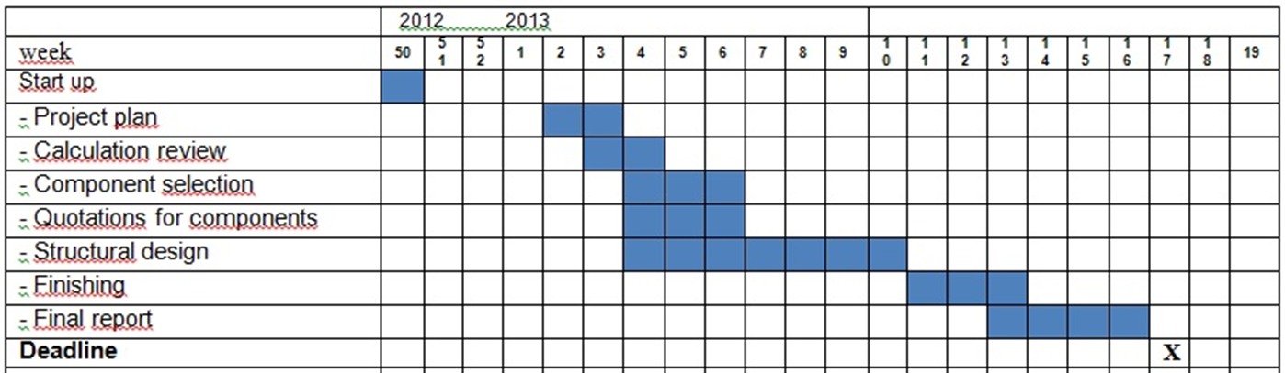
Timetable

Slide 6

Methods
Used methods:
  meetings, teamwork, brainstorming, stress analysis and 3D-design
  experts were consulted in difficult situations
  weekly meetings with the supervising teacher and project client

Slide 7
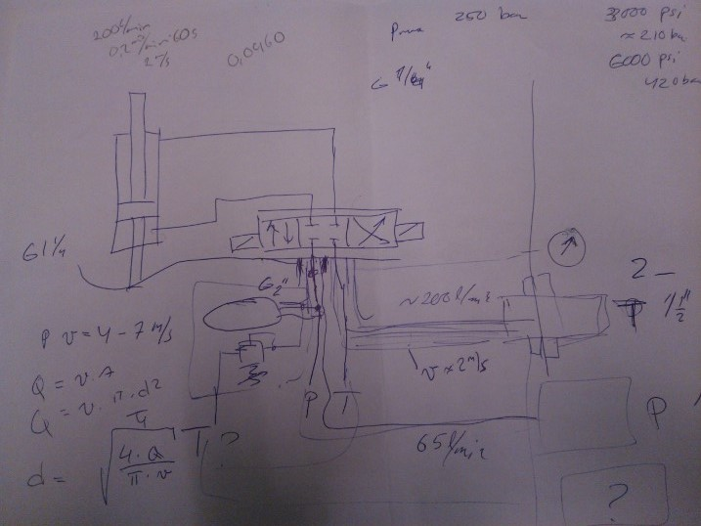
Results
Calculations:
  measurements of the components
  hydraulic and strength calculations
Choosing components:
  Calculations
Design

Slide 8
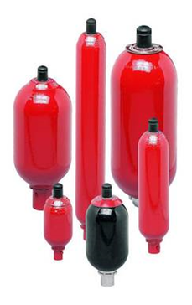
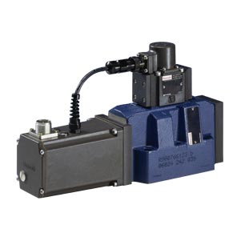
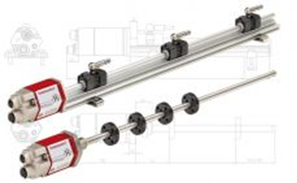
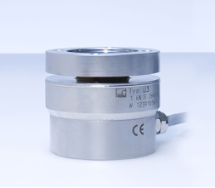
Chosen components
Pressure accumulator: Hydac, 20 liters, 1 300 €
Servo valve and a suitable base plate: Bosch Rexroth, 6 137 €
Force transducer: HBM, U3/50 kN, 1 520 €
Hydraulic cylinder including position transducer: Hänchen, series 320, 9 950 €

Slide 9

Design
A 3D-model of the dynamometer was made using the CAD program Catia
Some parts needed strict tolerances
Receiving 3D-models of the components helped
Working drawings were made of the 3D-model with Catia
Basic catalogue materials were used
Steel was chosen as material because of its strength and availability

Slide 10
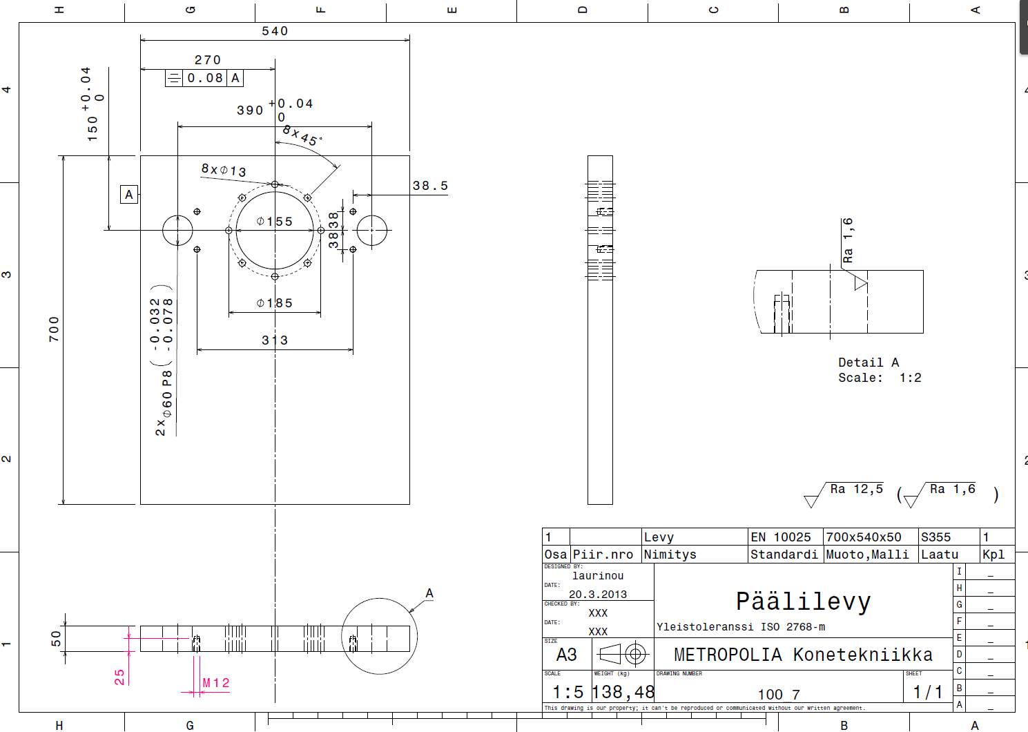

Slide 11
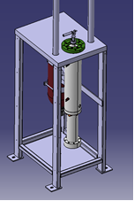
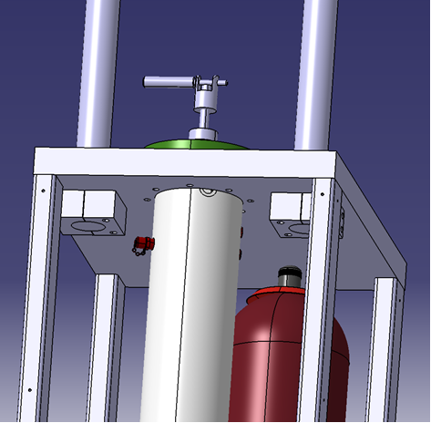
Conclusions
As a result, it was found out that the component prices and estimated body manufacturing costs are less expensive than the reference product.
The reference unit price was about 120 000­­­–150 000 €, and the estimated costs of the designed model will be 20 000–25 000 €.

Slide 12
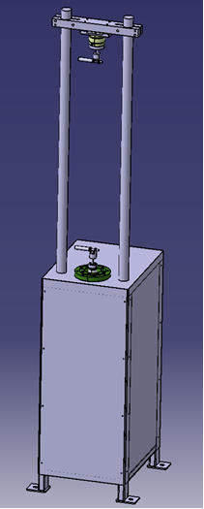
Conclusions
Functional design was successfully made.
The project group was efficient and there were no critical difficulties.
The supervisor and client were available when needed.

Slide 13
Thank You for listening!
Questions are welcome

