Slide 1
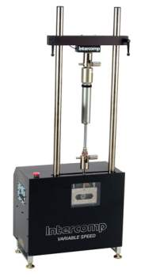
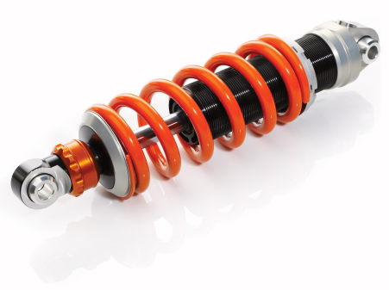
Shock Absorber Dynamometer
Aripekka Rajoo, Anssi Petäjä, Janne Rantanen, Lauri Nousiainen

Slide 2
Team members
Anssi Petäjä, Project leader
Aripekka Rajoo, Secretary
Janne Rantanen, Designer
Lauri Nousiainen, Designer
Heikki Paavilainen, Supervising teacher
Pasi Oikarinen, Orderer

Slide 3
Objective
The objective of this project is to design a shock absorber dynamometer for the Automotive laboratory of Metropolia University of Applied Scienses
The project is restricted only to the design.
The design is limited to the structure and operation.
The result should be a functional construction.
The quotations for components will be requested from the suppliers.

Slide 4
Methods
Used methods will be:
  Meetings
  Teamwork
  Brainstorming
Used programs will be:
  Catia
  Mathcad
  Abaqus
  MS Office

Slide 5
Stages
Project plan: lays the foundation for the implementation of the project.
Calculation review: hydraulic calculations of the previous project must be checked before the selection of components.
Component selection: choosing the components of the basis of the calculations and requirements.
The quotations for components will be requested from the suppliers.
Structural design: construction and attachment design. Additionally, the potential strength calculations are calculated.
Finishing: finish the project, drawings and the final report.

Slide 6
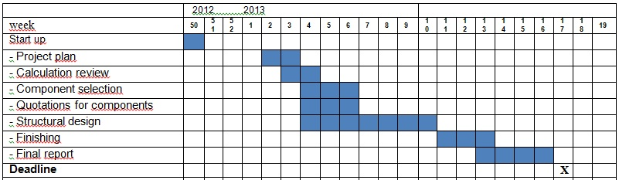
Time Schedule

Slide 7
Costs
Reference unit price is about 120 000­­­–150 000 € (170 000 $), but the aim of the project is to produce a less expensive device.
Cost estimates:
  Position sensor: German Jet 1700 Series with 375 mm stroke length, 300 €
  Force sensor: Scaime MS02 20 kN, the price is unknown.
  Pressure accumulator: Hydac Ltd 24L , 1300 €
  Servo valve: Bosch Rexroth and a suitable base plate, the price is unknown.
  Cylinder: Hänchen Double Rod Premium Series 326, 10000 €
  Body of materials and manufacturing: students manufacture the device at the school, so the price is only the prices of materials.

Slide 8
Risks
The possible risks are:
  Key personnel involved in the project is not available, e.g. disease.
  Requirements specification unclear.
  Changes of the requirement definitions during the project.
  Problems with group communication.

Slide 9
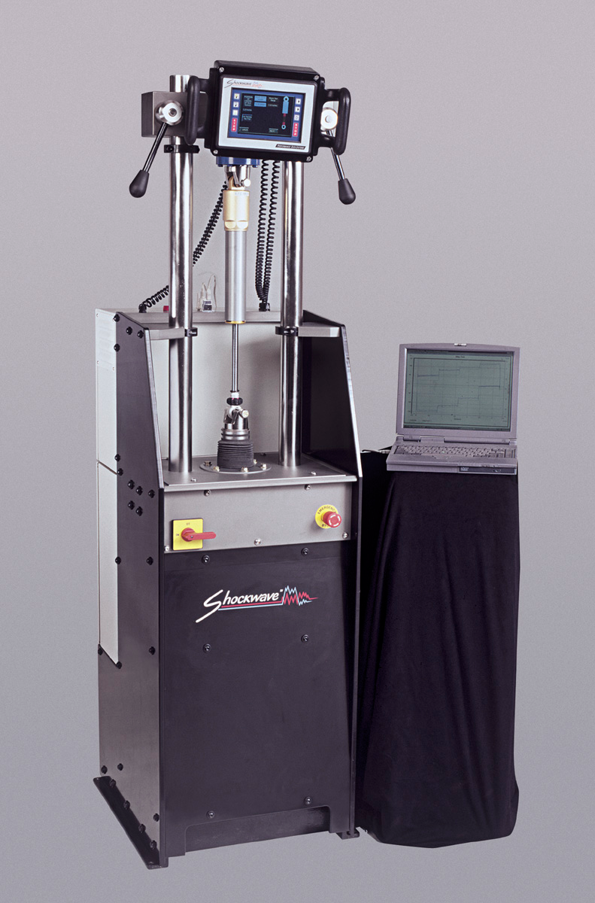
Video clip

