Slide 1
Delcos Tiles
Andreas Stenroth
Eero Heinonen

Slide 2
Aperiodic tiles
If you divide a plane to parts like Delcos Tiles, there are no periodic forms like squares or triangles

Slide 3
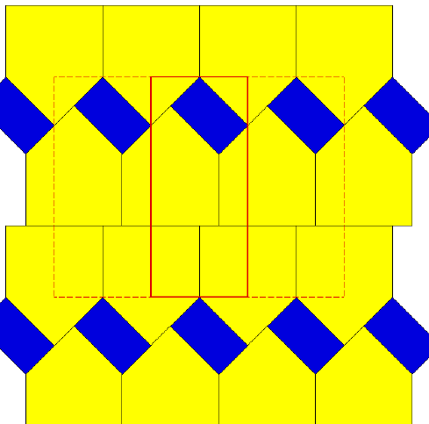
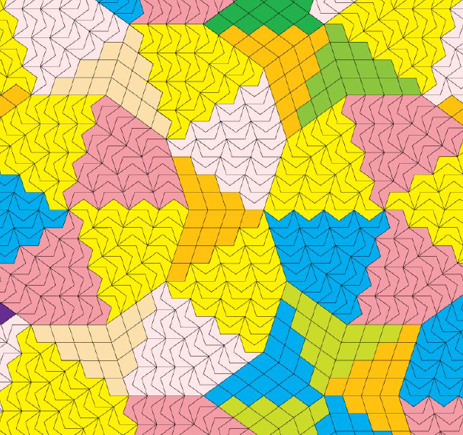
Aperiodic tiles
Periodic tiles

Slide 4
The project goals and objectives
Aperiodic tiles can be used for example in pedagogical, festive and construction-related purposes
The objective of the project is to find out suitable materials for aperiodic tiles and what are their production methods and costs
The goal is to find such methods of production that it is economically viable to produce them

Slide 5
Timetable and stages
The project was started in December 2012 and it is going to be ready in the begining of May 2013
The body of the project schedule is based on project meetings which are held every second weeks

Slide 6
Methods and tools
Literary research
Meetings and teamwork
Manufacture of the prototypes

Slide 7
The team
Students: Andreas Stenroth, Eero Heinonen
The guiding teacher: Arto Haapaniemi
The creator of the idea: Mr. Kari Delcos, an artist and a mathematician
No project manager or other officials, just pure teamwork…

