Slide 1
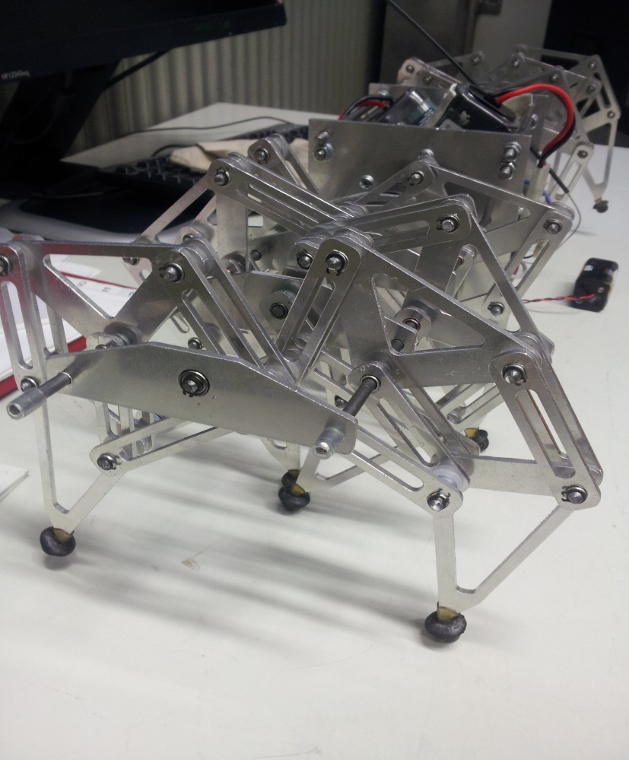
BEAST V3
Picture of Version 2

Slide 2
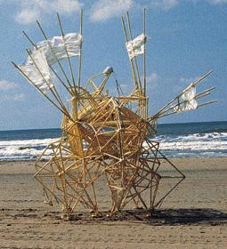
History
A Dutch engineer called Theo Jansen's has invented StrandBeest, which moves with the wind as a source of power.
Beast V1 was made for thesis and project by two Metropolia students in spring 2012. Exchange student from Japan developed Beast V2 in autumn 2012. Its metallic and a remotely operated.
It could be used in awkward places such as woods. It allows Beast's move easily in the places where people would have trouble walking.

Slide 3
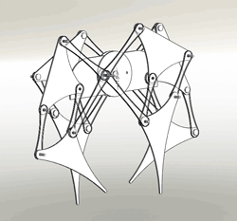
The mechanism in action

Slide 4
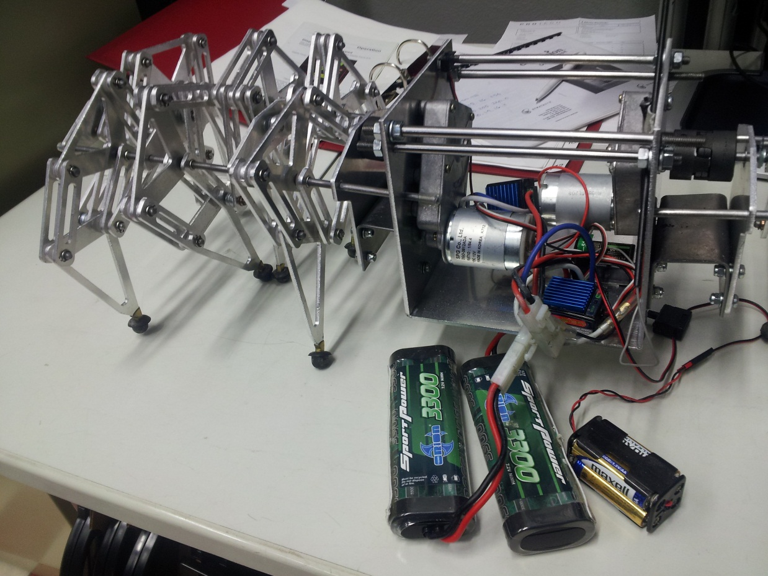
Objective
Research and develop Beast V2 to Beast V3 by improving:
- Movability
- Turnability
- Controllability
- Stoutness
- Durability

Slide 5
Methods
Find out important weaknesses of previous version
Designing of new parts
Further development of proposals
Reporting and ending the project

Slide 6
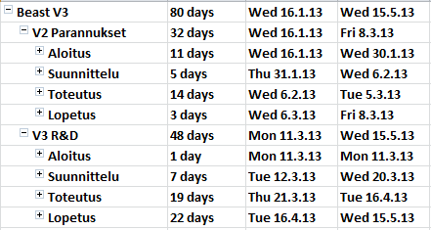
Schedule
Project start 16.1.2013
Reseach and repair V2
Developing V3
Release V3 (16.4.2013)

Slide 7
Costs estimate and risks
Budget is 500€
The risks for the delay or failure of the project are the costs of V3 accessories.
If the device does not work at all

Slide 8
Questions?
    ?

