Slide 1
School path:
Specific Details
Jenny Haapasaari
Peppi Hiidenkari
Sonja Lepistö

Slide 2
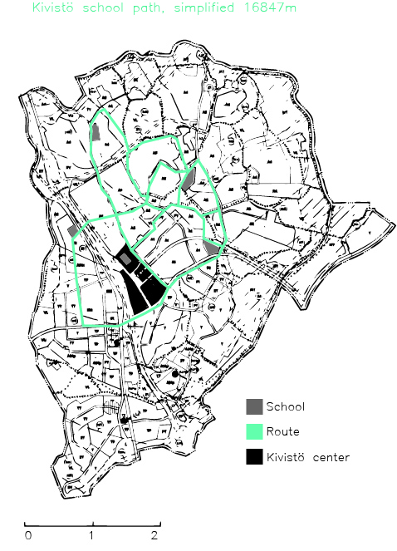
Simplified map

Slide 3
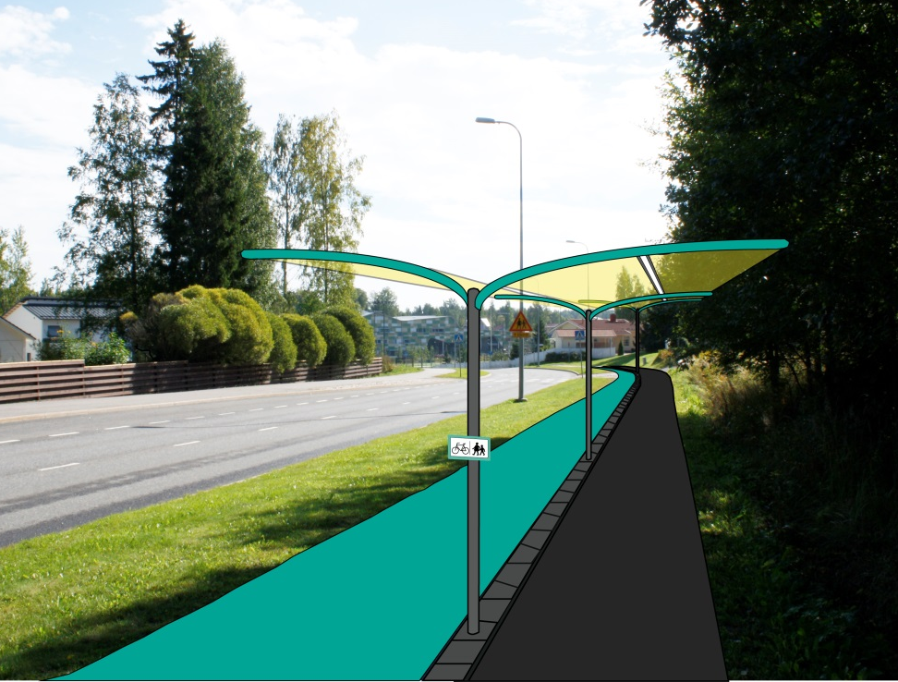
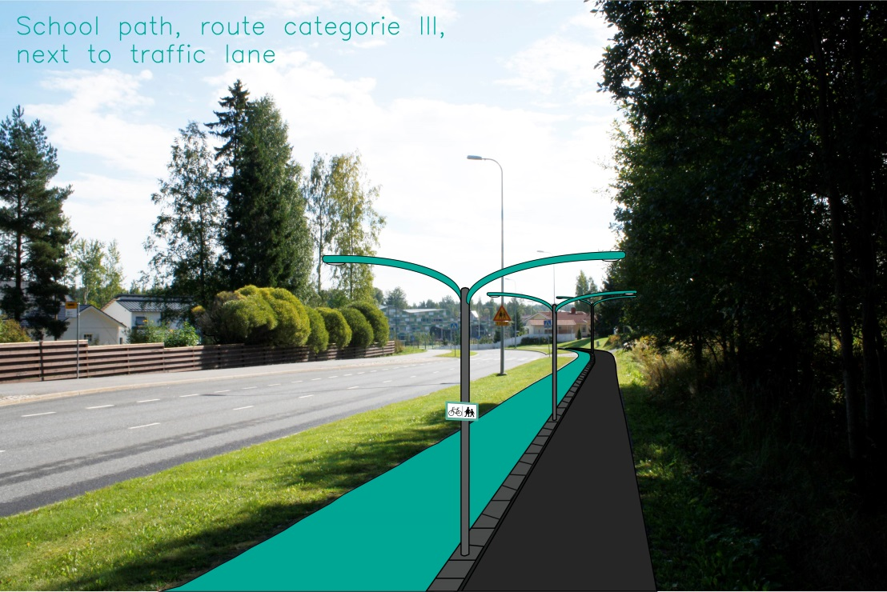
Lightening & Illustrations
Integrated led lights, which goes same direction as route.
Street lights with turquoise paint.

Slide 4
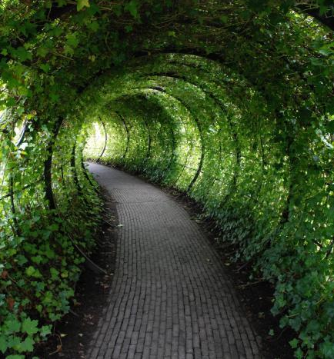
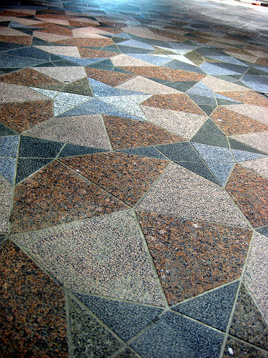
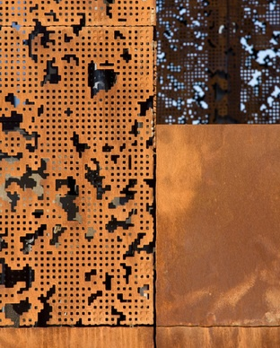
Housing fair area: Details
Tunnels, pinwheel tiling for pedestrian areas, corten steel.

Slide 5
What we are going to do next?
Signage f.ex. Information board
Illustrations
Printed material
Final touch

Slide 6
Meeting with director of planning
We are going to present our project to different specialists working on kivistö area.
New information from the current situation in kivistö: cycle highway, plans for parks, art elements.

Slide 7
Thank you!

