Slide 1
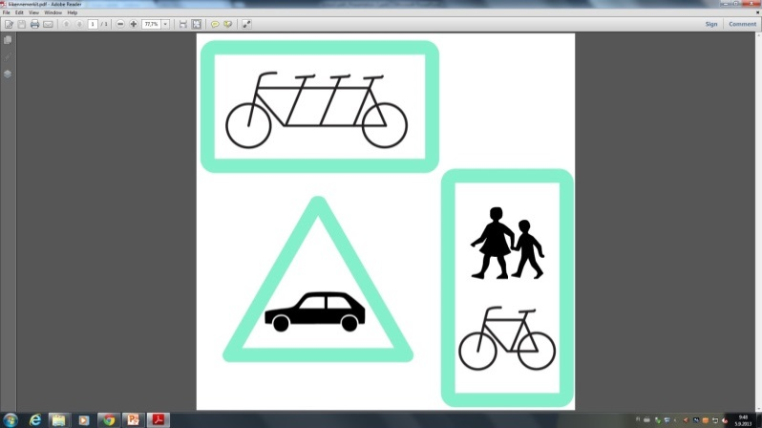

SCHOOL PATH:
Updated Content
Jenny Haapasaari
Peppi Hiidenkari
Sonja Lepistö

Slide 2
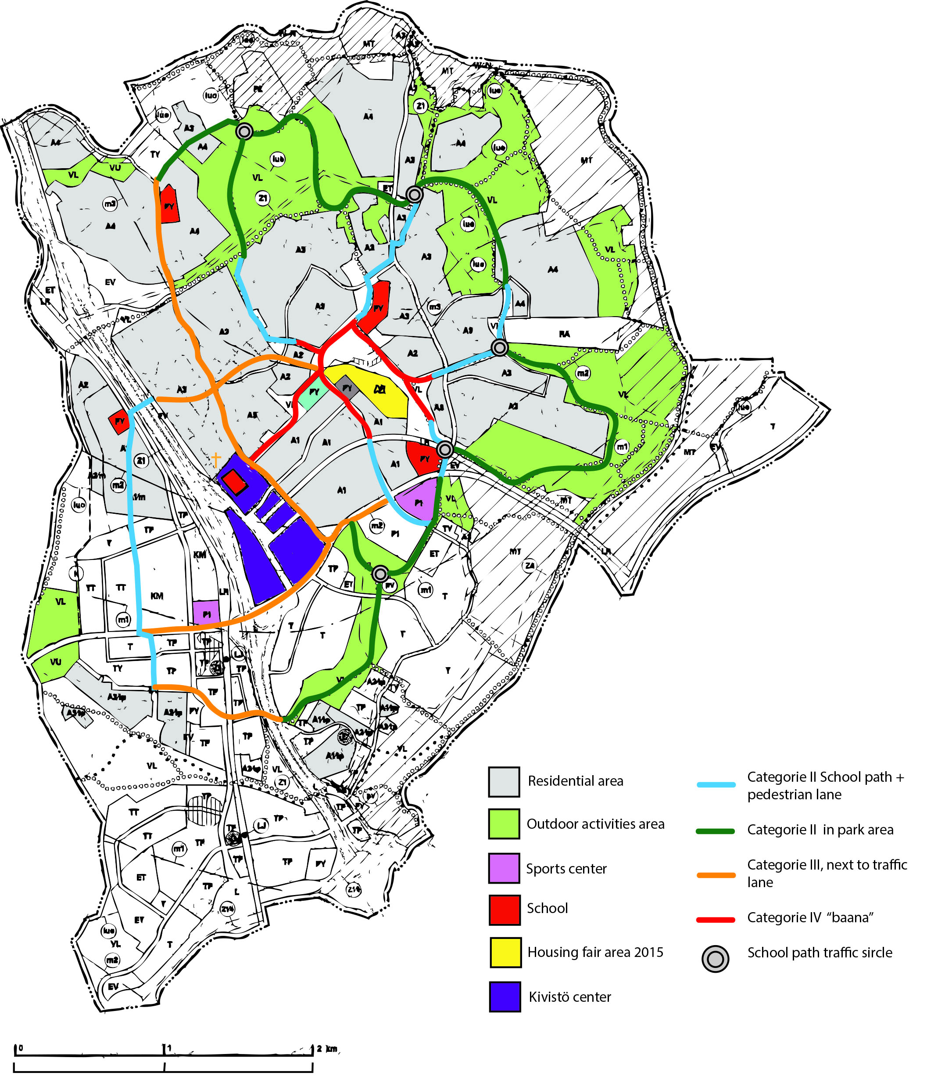
I Integrated School Path
(not in the map)
The cheapest version, used only if the budget is tight. Suitable for existing or planned pedestrian lanes.
Minimum demand is the Acrylotex coated lane and separation lane.
On sand roads stone dust surface and painted line.
II School Path + pedestrian lane
Suitable for parks and regional routes.
III School Path + pedestrian lane + traffic lane
Suitable for use next to traffic lane.
IV School Path “baana”
Suitable for the main School Path road in Kivistö Center area.
Path lenght total:
25,347 km
.

Slide 3
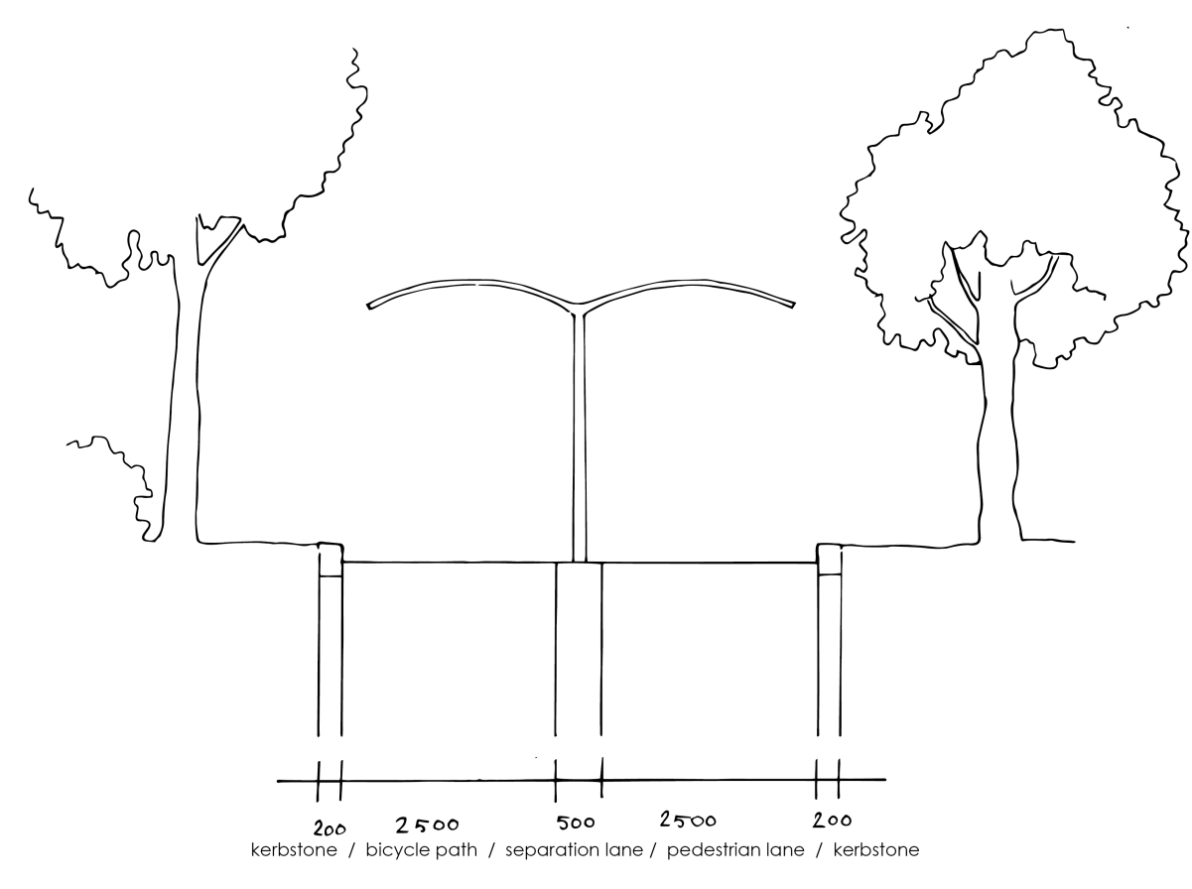
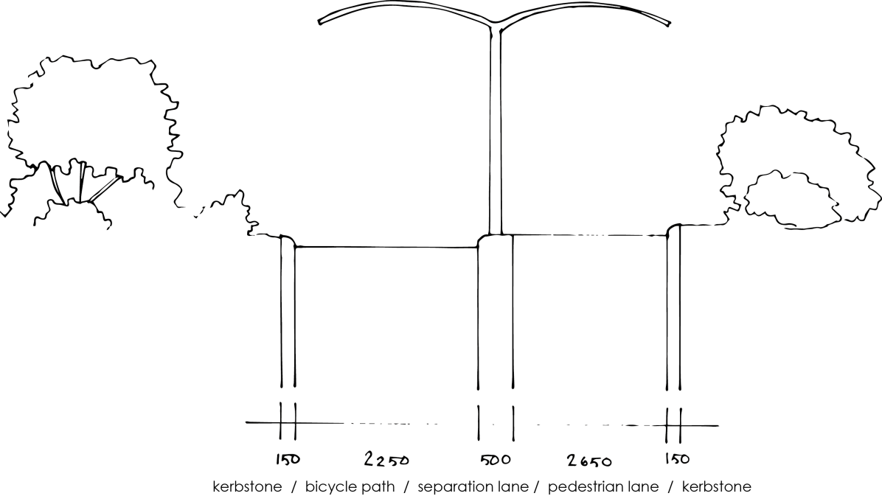
Lane type solutions: Categorie II
Same-level solution.
Bicycle lane and pedestrian lane are on the same level.
This path could be a sandroad or acrylotex coated.
Two-level solution.
Bicycle lane and pedestrian lane are on different levels to prevent children from cycling to the pedestrian lane.

Slide 4
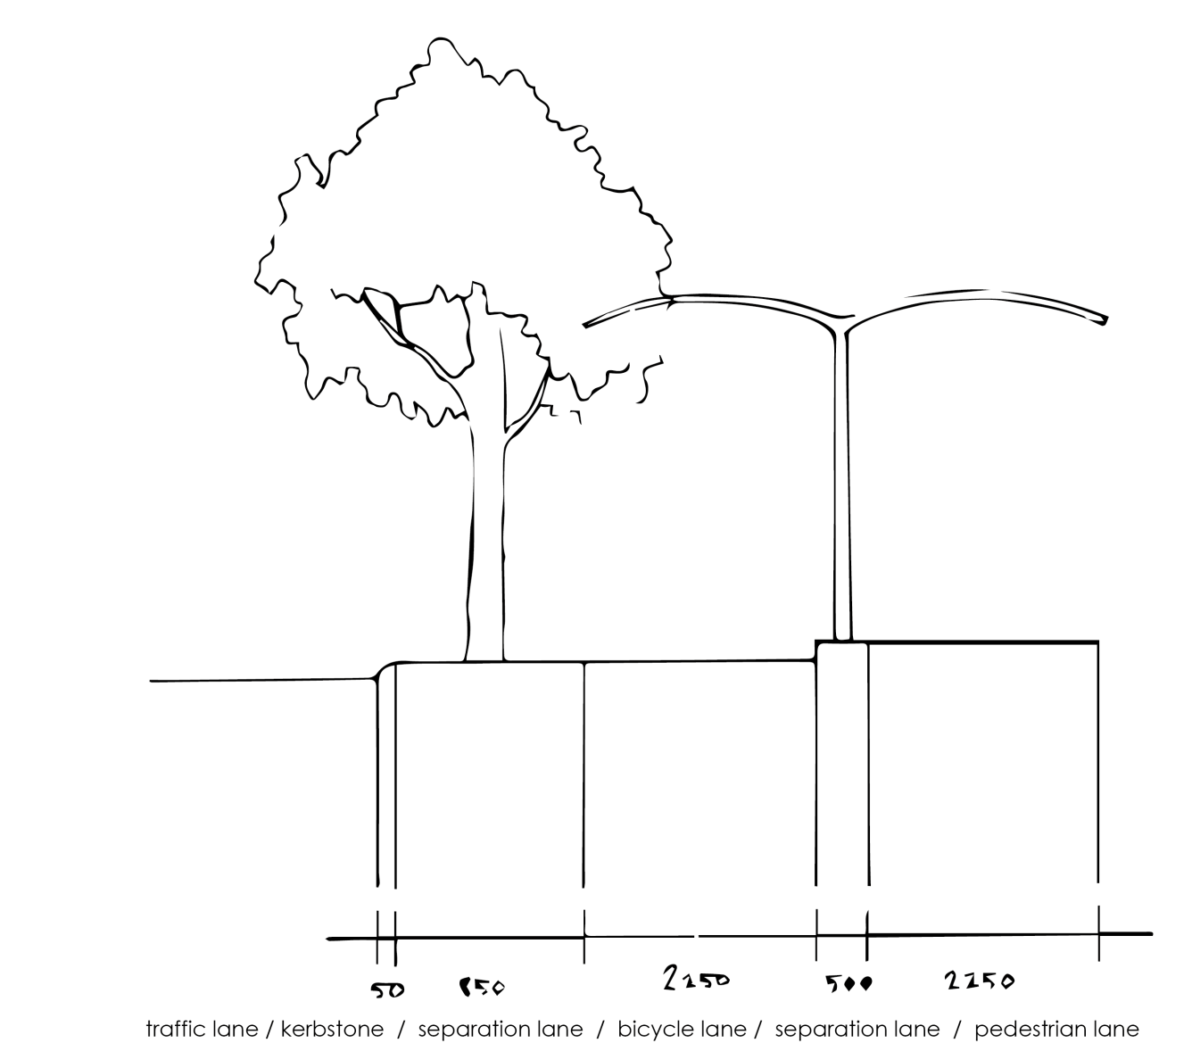
Lane type solutions: Categorie III
Three-level solution separates the traffic, cycling and pedestrians effectively and brings a sense of safety.
Same-level solution has the same cross-section but everything is on the same level.

Slide 5
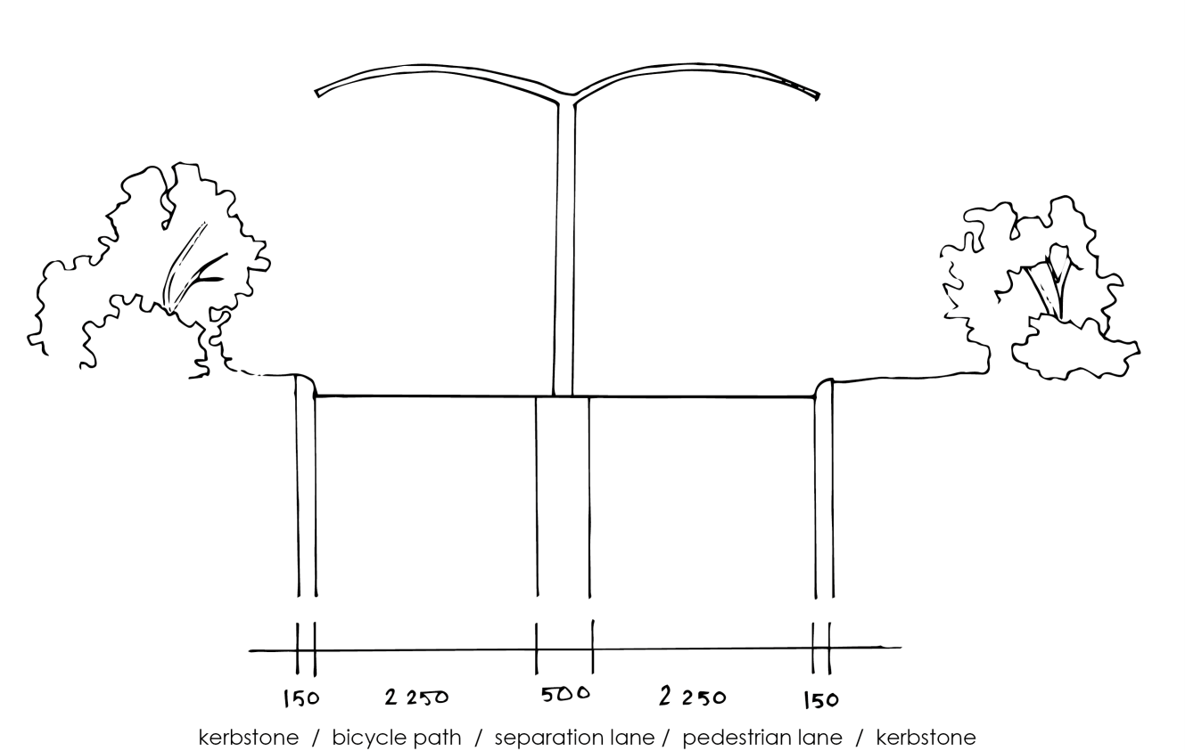
Lane type solutions: Categorie IV
School Path ”Baana”.
The lanes are wide and have a separation lane between them.
This path categorie is the only one to have a shelter.

Slide 6

School Path: Logo

Slide 7
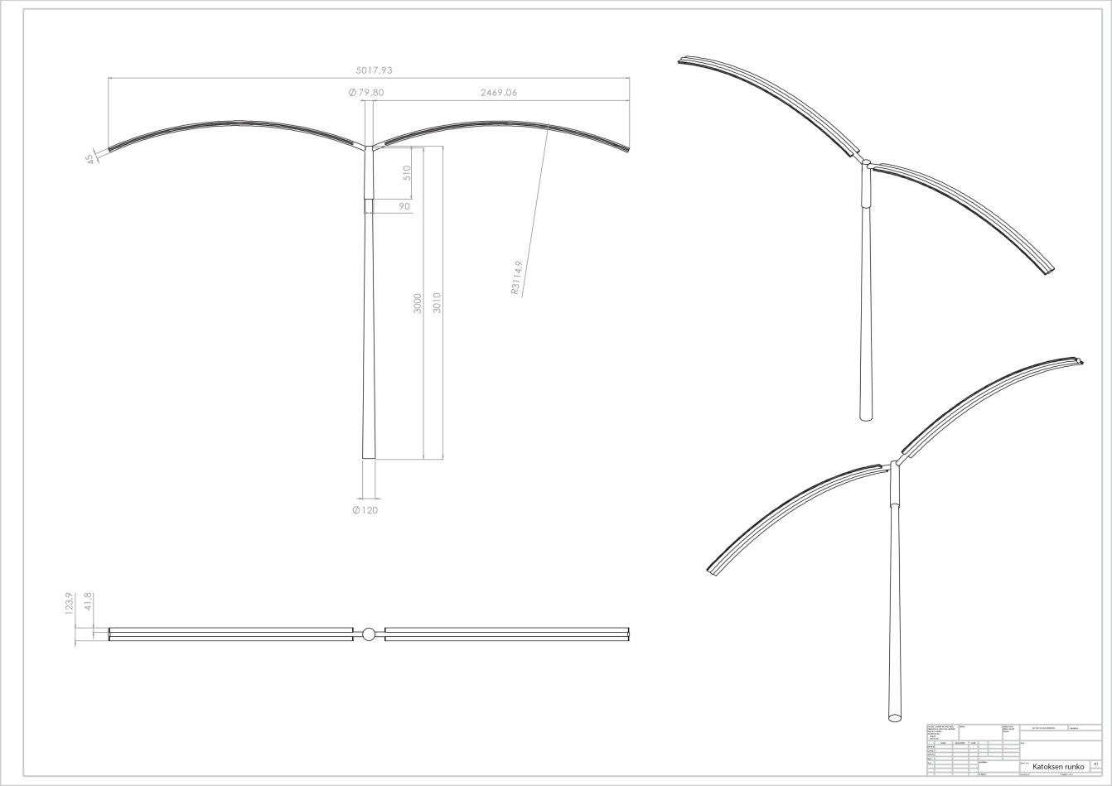
Shelter for the ”baana”
Shelter for the ”baana” should contain demands of natural and circular shapes. That have mensioned in Marja-Vantaa design manual.
It will be good element to separate pedestrian and cycle lanes.
Measures are based on the light traffic planning file. (Tiehallinto)
Shelter well be light as possible.

Slide 8
What we are going to do next?
Final map
How lane types ( I, II, III, IV ) changes to another
Illustrations for path details
Spesific details for the house fair area
Planning lights & singnage

Slide 9
thank you!
Questions & Comments?

