Slide 1
Signposts and traffic signs
&
Bicyclists: manners and behaviour
Jenny Haapasaari
Peppi Hiidenkari
Sonja Lepistö

Slide 2
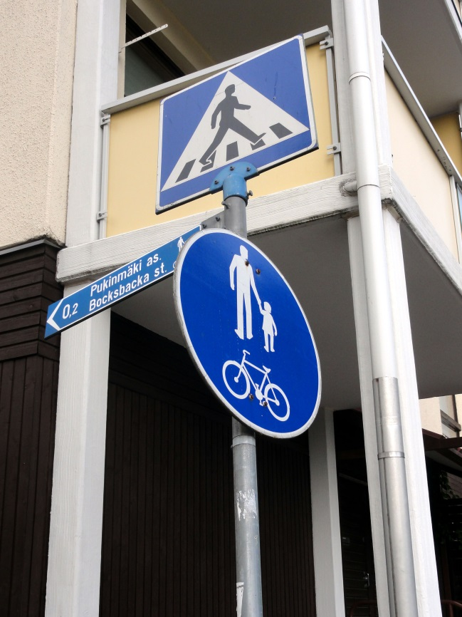
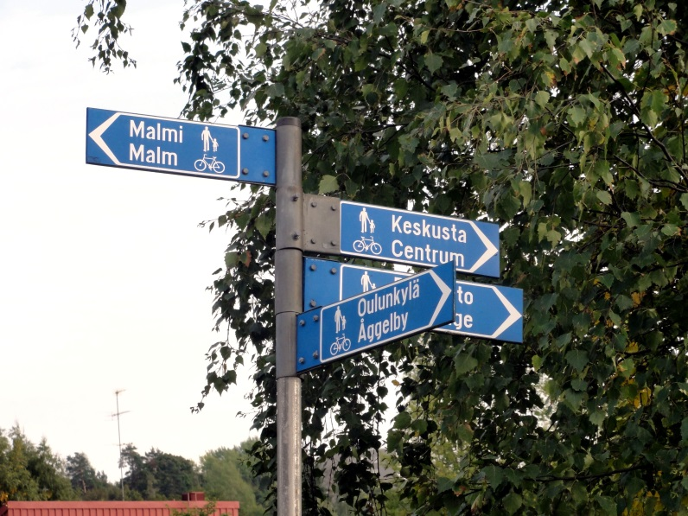
Signposts
Two or three colored signs and simple symbols are very clear to understand.
Signposts are typically too high and the font is too small. When you’re cycling too fast, it’s impossible to perceive the information.

Slide 3
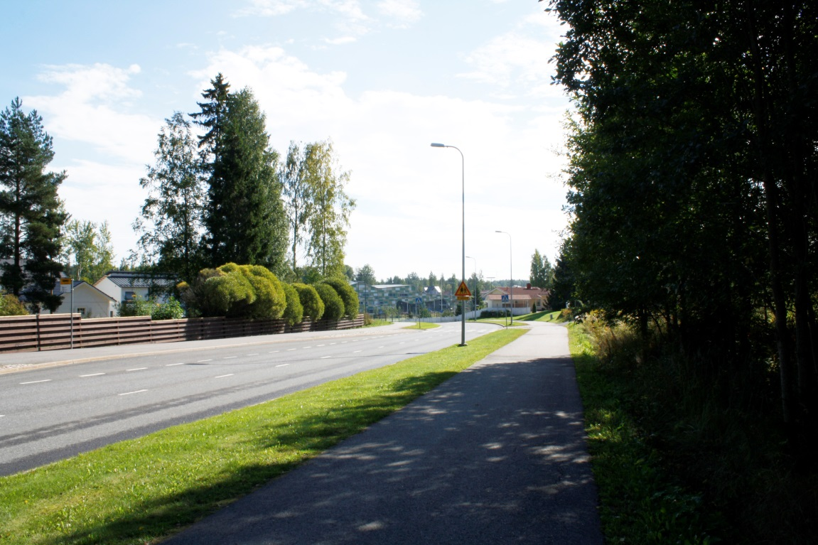
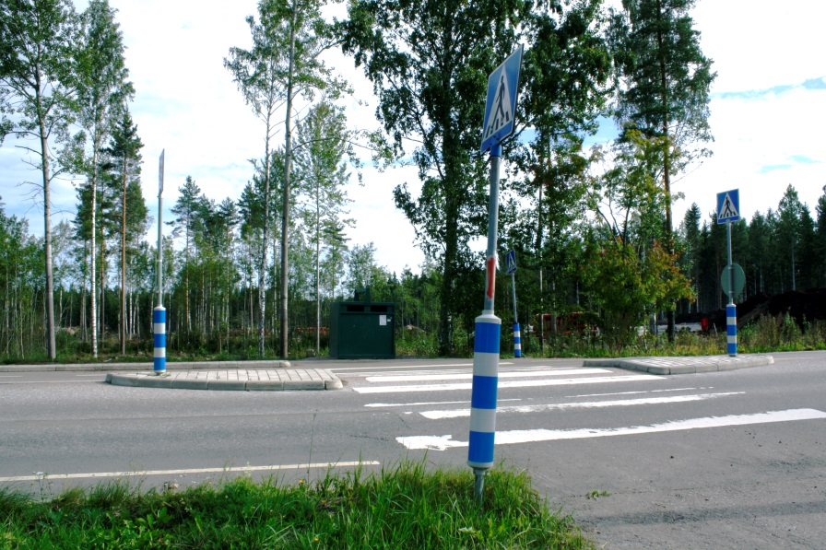
Traffic signs
This sign warns about children; usually sign is near of the school
Crossing area near the school. Four signposts and reflectors on the poles.

Slide 4
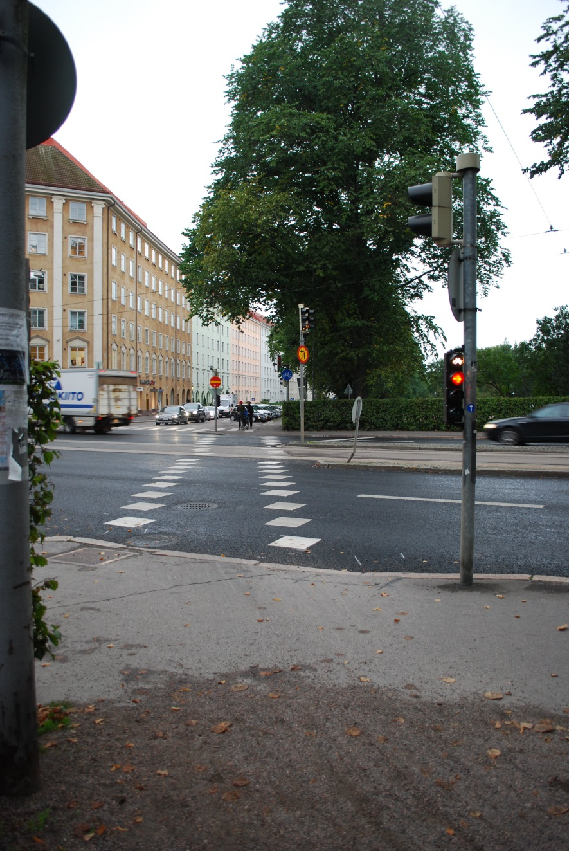
Traffic signs
Traffic lights for bicyclers. This is very useful and practical specially in the center area.

Slide 5
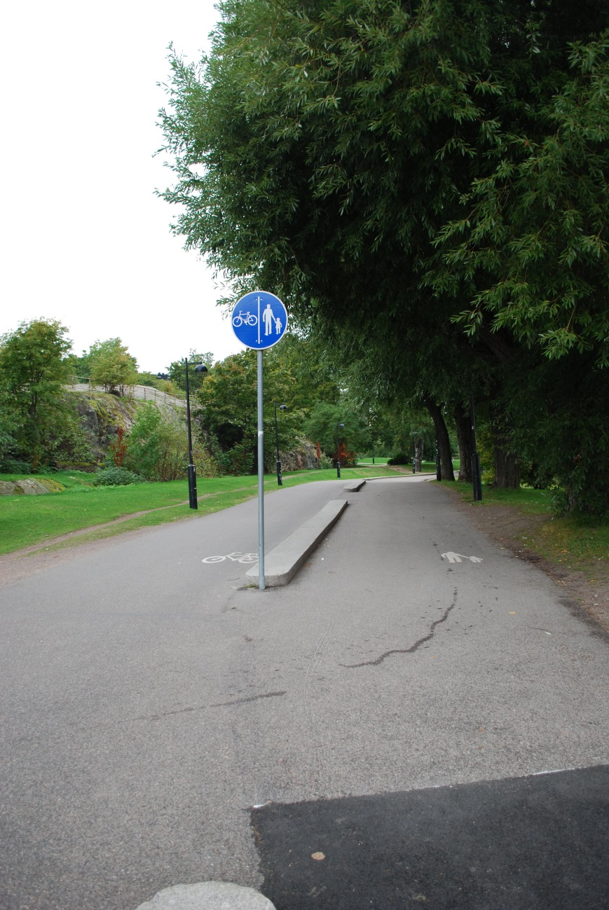
Traffic signs
Pedestrian and cycle path is separated by increased paving. Safer than just painted line.

Slide 6
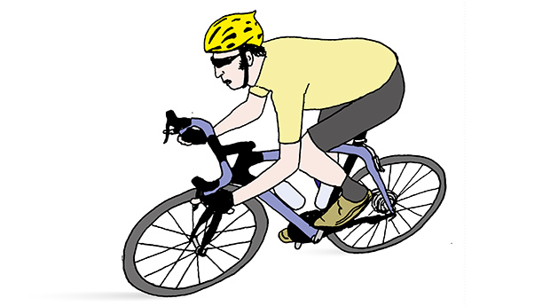
Behaviour & manners
Often danger situations arise because people doesn’t ring the bell or they don’t even have it.
Sometimes passing causes danger when it happens from the wrong side of the road.
Usually too high speed in the city area. Causes danger situations!
Often people cycle on the pedestrian lane because they doesn’t dare cycle on the motor road.
http://nyt.fi/20130614-aeaenestae-aersyttaevin-pyoeraeilijae/

