Slide 1
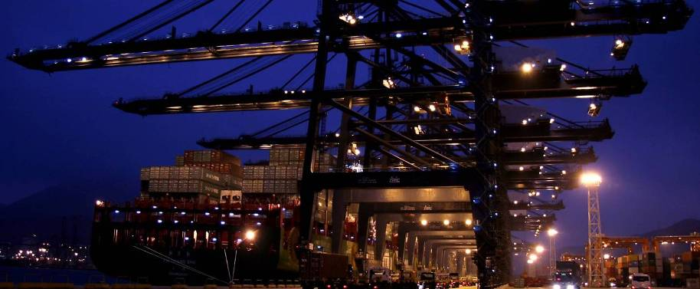
Janne Kaskinen & Uula Torttila, 16th of January 2014
Metropolia Assignment
Harbor Cranes

Slide 2
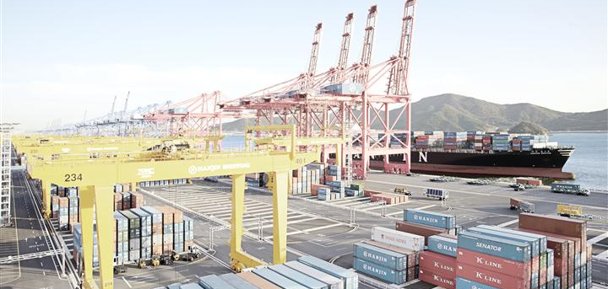
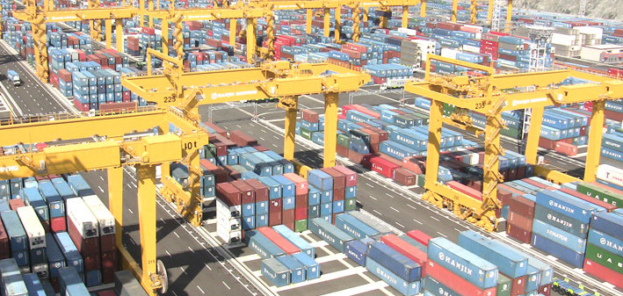
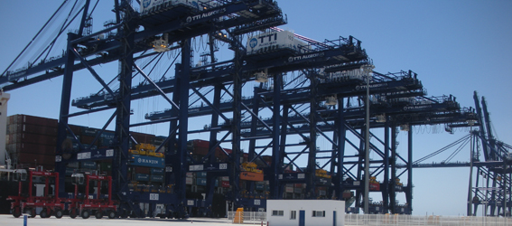
Metropolia Assignment Harbor Cranes
Main tasks
Mapping of the harbor crane installed base on certain specified geographical areas and locations
Evaluate the related service and modernization business potential on these referred areas and locations

Slide 3
Metropolia Assignment Harbor Cranes
Main tasks
By using several methods and tools, like internet and glossaries, mapping the harbor crane amounts and types on container terminals, harbors (bulk, general cargo, intermodal etc.) and shipyards
Container terminal | Bulk terminal | General cargo terminals | Shipyards | Intermodal / River terminal
Ship-to-Shore (STS) | Grab Ship Unloader (GSU) | Slewing cranes | Goliath Gantry Crane (GGC) | Gantry cranes
Rail Mounted Gantry (RMG) | Slewing cranes |  | Single/Double boom level luffing slewing crane (heavier) | Slewing cranes
Automatic Stacking Crane (ASC) |  |  | Single/Double boom level luffing slewing crane (lighter)
Rubber Tired Gantry (RTG) |  |  | Small gantry cranes & outdoor EOT’s

Slide 4
Metropolia Assignment Harbor Cranes
Main tasks
Finalize the first assignment
Evaluate the cranes in 10 major shipyards in the USA
Evaluate the cranes in 10 major shipyards in Europe
Source out the approximate investment cost for a harbor crane per type and size – to be provided by ABB
Source out the approximate annual service cost for a harbor crane per type and size – to be provided by ABB
Verify the approximate service cost (Port of Helsinki (FinnSteve, Steveco, MultiLink), Port of Kotka-Hamina etc.)
Divide the annual service cost between mechanical and electrical maintenance (in %)
Divide the annual service cost regarding the means of preventive maintenance, corrective maintenance and other maintenance/service.

Slide 5
Metropolia Assignment Harbor Cranes
Crane investment and service costs
Crane type | Investment (MUSD) | Annual maintenance cost (% of investment cost)
STS | 8-12 MUSD | 1-2 %
RMG | 1,5-3 MUSD | 2-3 %
ASC | 1,5-2 MUSD | 1,5-2 %
RTG | 1-2 MUSD | 2-4 %
GSU | 8-16 MUSD | 2-4 %
Global service market in harbor crane business is around 5-10 BUSD
  Terminals take care around 80 % of this

Slide 6
Metropolia Assignment Harbor Cranes
Geographical Areas and Locations
USA
UK
Ireland
Italy
Korea
Vietnam
Malaysia
Thailand
Netherlands
Belgium
Germany

Slide 7
Metropolia Assignment Harbor Cranes
Project plan
The assignment will be carried out by a student group of three to four (3 – 4) students.
The approximated total workload will be
  Approximately 200 hours (= 4 * 50h) for carrying out the planning and analysis phases, and for writing / compiling the Assignment report
The students will have a mid-point review with the company to enable early evaluation of the assignment and possible corrections to the plan
Summarize team’s finding and present to ABB global Crane Services team

Slide 8
Metropolia Assignment Harbor Cranes
Project group
Janne Kaskinen janne.kaskinen@fi.abb.com +358 50 3329390
Uula Torttila uula.torttila@fi.abb.com +358 50 3323875
Timo Junell timo.junell@metropolia.fi
Markus Kilpiäinen markus.kilpiainen@metropolia.fi
Joonas Toivonen joonas.toivonen@metropolia.fi
Eetu Soukko eetu.soukko@metropolia.fi

