Slide 1
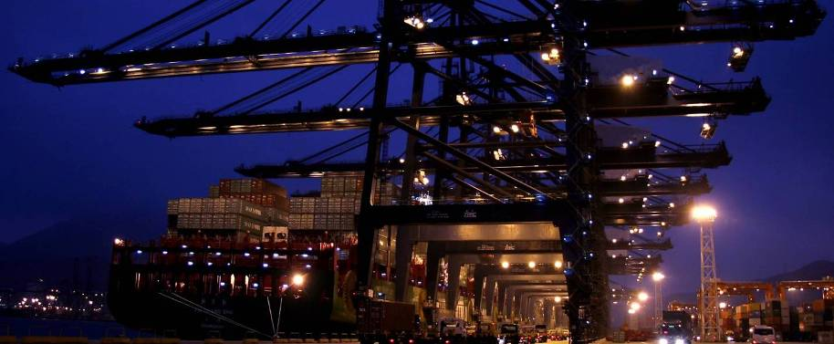

Joonas Toivonen, Markus Kilpiäinen & Eetu Soukko
Metropolia Assignment
Harbor Cranes

Slide 2
STS crane maintenance costs:
Investment cost: 6-9 M€ (estimated maintenance costs 1-2%)
Maintenance costs (confirmed by Jukka Muuri, Steveco Mussalo)
Mechanical: (60%)
Lifting cables: ~10 000€ (in every 3 years)
Lifting device: ~10 000€ (if destroyed accidentally)
Folding joint of lifting boom: ?€ (3-5y, warranty by Konecranes)
Repairing microruptures in frame (in every 10 years)
Internal corrosion
Electrical: (40%)
Electrical switches and light bulbs (small costs)
Inverters and Capacitors: ~10 - 30 000€ (in every 10 years)
Hanging cables: ~10 – 100 000€ (in every 10 years)
PLC out of date —> Electrical modernisation: ~100 000€ - 1 M€
Main cable in frame: ?€ (in every 10 years)

Slide 3
STS crane maintenance costs:
Corrective maintenance: (90%)
Other maintenance: (10%)
Mika Niskanen, Finnsteve Vuosaari:
”According to our STS-crane care agreement, annual maintenance costs are 1,61% of investment costs in the beginning of cranes’ lifetime. Unfortunatelly I can’t detail the cost structure.”
(4pcs Kalmar Post-Panamax STS-cranes)

